Slide 1

Critical Design Review (CDR)
February 10, 2024
SilverSat’s CubeSat and Mission Details
Notes:
Green highlight needs to be edited

Slide 2

Success Criteria for the Review
All Board design changes have been identified for the Flight Model
Flight Software development is well underway and has been tested as part of the Prototype 2 test campaign
Prototype testing demonstrates Level 1 requirements
Mechanical fit check is complete and successful
Slide

Slide 3
Logistics
Welcome to APL’s B201 Auditorium!
Bathrooms are outside and to the right of the Auditorium double doors
Food is in the back of the room, please help yourself
Please silence your cell phones
For the attendees on the Google Meet, please mute your microphone
The CDR is scheduled to run from 2:30 - 5:30 PM, but there is a lot of material to cover. At ~3:30 PM, we will do a time check to see where we are at in the presentation
Slide

Slide 4
Overview of SilverSat Limited
Multi-year community-based non-profit serving Silver Spring area tweens and teens
Goals include STEM enrichment “to discover and expand knowledge”* and leadership development among tweens and teens, including those from underrepresented and underserved groups in STEM fields
Diverse student participation -> different perspectives on the different challenges we face throughout this program
~15 Students in grades 6-12 as well as in college
Mix of public, private, and home-schooled students
Greater Silver Spring area: DC, Maryland, and Virginia
Many different personal interests and aspirations
* NASA 2018 Strategic Plan, NASA Vision - p.6
Slide
Notes:
Zoe

Slide 5
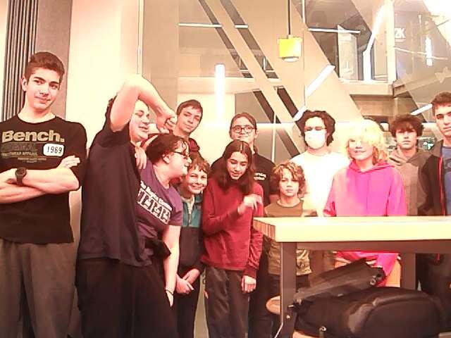
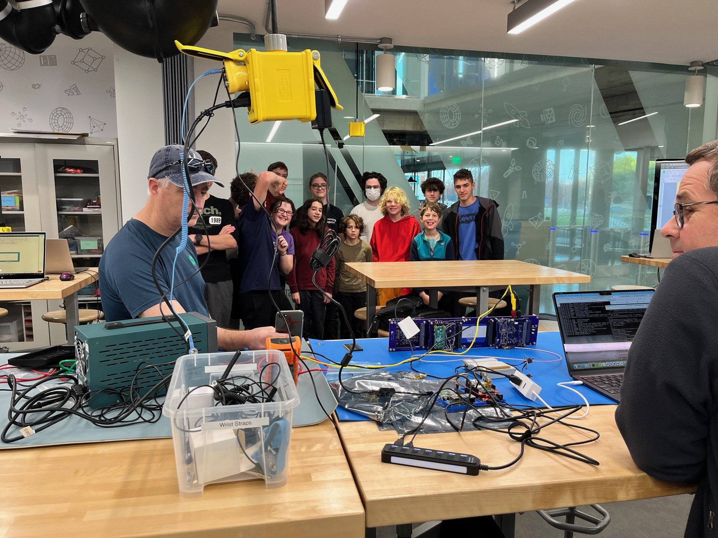
Outline
Overview & Mission Concept
Systems Engineering
Critical Designs (Major Components)
Power, Avionics, Radio, Payload, Mechanical, Ground
Prototype 2 Results
Flight Model (FM) Integration and Test Flow
Programmatics
Conclusion/Outbrief
Slide

Slide 6
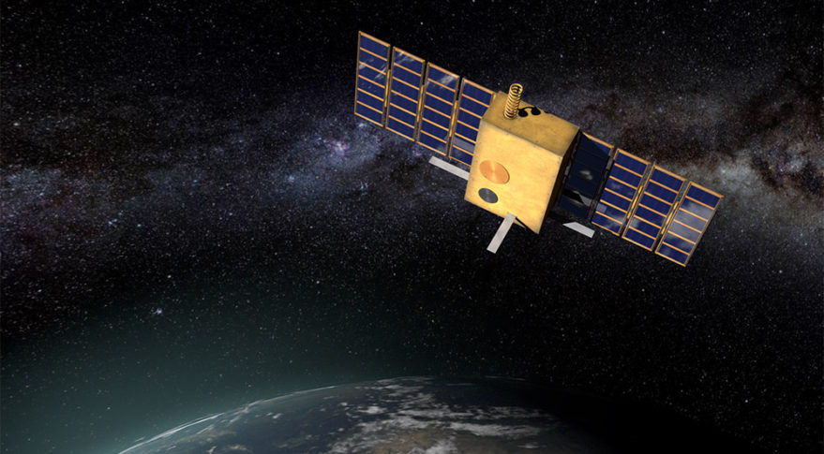

Mission Concept
SilverSat is a CubeSat that…
Takes photos of Earth during its orbit and, when in contact with a ground station, logs into X (formerly Twitter) and posts its photos and mission data as posts (formerly Tweets).
Slide
Notes:
Aubrey

Slide 7
Updates Since the Preliminary Design Review (PDR)
Completed designs of printed circuit boards (PCBs)
Finished Prototype 2 testing
Began ordering and receiving Boards and parts for the Flight Model
Implemented, tested, and integrated the Payload, Avionics, and Radio Boards Software
Established and prototyped the Ground Station
Found a new location for building the CubeSat
Established alternatives to X (formerly Twitter)
Slide
Notes:
Zoe

Slide 8
PDR Action Items
Action | Status | Notes
Come up with ideas of how we could use our extra mass margin. | Closed | Team conducted trade study, decided to pursue a backup battery. Ultimately did not incorporate due to heater power.
Find out what other CubeSat missions have used the uCAM camera from 4D Systems. Ask them how well the camera performed, if they had any issues, and what did they do about direct sun illumination. | Closed | Identified five other missions that have used this camera. No additional information on how they avoided direct sunlight. Payload Team met with Dr. Dan Moses for input, and conducted independent assessment of possible Sun damage.
Put together ideas for load shedding. What could our CubeSat do if it needed to turn off loads to save power? Does the EPS already have this function? Decide what if any design changes to make from these ideas. | Open | EPS will shut off bus supplies if Batteries fall below threshold. 5V and 3.3V can be powered down separately.
Try to determine soon what the ground station will be and test it with the AX5043. | Closed | Ground Station Radio is a copy of the CubeSat Radio with external PA, LNA, and switch. Prototype testing conducted with an AX5043 Prototype Board as the Ground Station.
Contact Dave Kubalak concerning ideas for 3-D printing the camera’s lens housing, and about possible lens that are better suited for flight. | Closed | Payload Team contacted Dr. Kubalak after PDR.
Slide

Slide 9
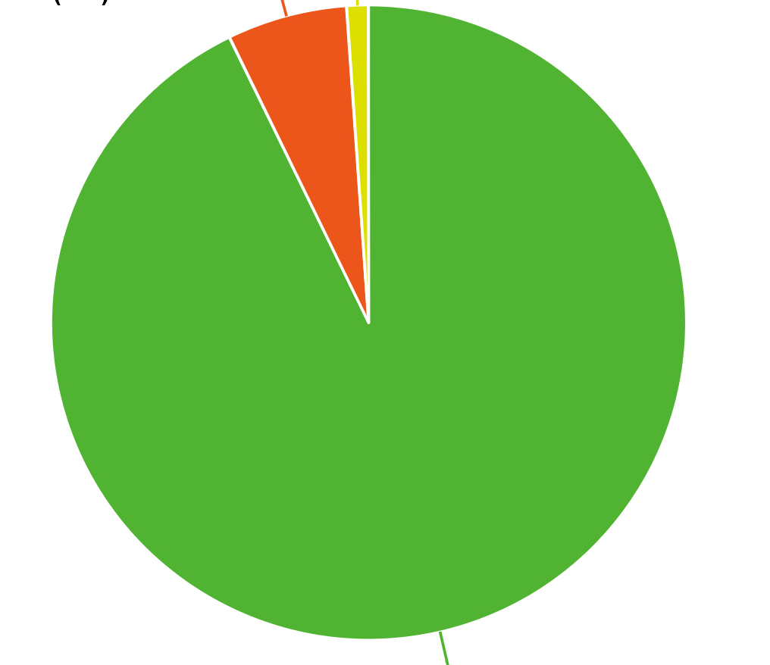
Concept of Operations
Photo: Take pictures of the Earth from Space
Comms: Communication with Ground Station, automated tweet of photo, status
Sleep: Idle, conserve power, wake for photo or communication, beacon
Photo
Sleep
Comms
Total: 90 minutes
(1 Orbit)
Slide
Notes:
Zoe

Slide 10
CubeSat Block Diagram
Solar Cells
CubeSat Size: 1U
NTE Size: 10cm x 10cm x 11cm
NTE Mass: 1.33kg
EnduroSat EPS
Antenna
Radio Board
Avionics Board
Payload
(Raspberry Pi)
Board
Camera
Slide
Notes:
Zoe

Slide 11
Outline
Overview & Mission Concept
Systems Engineering
Preliminary Designs (Major Components)
Power, Avionics, Radio, Ground, Payload, Mechanical
Prototype 2 Results
FM Integration and Test
Programmatics
Conclusion/Outbrief
Slide

Slide 12
Level-2 Requirements
Take a picture of Earth
Shall have a camera
Shall point the camera towards Earth in the northern hemisphere
Shall know when to take a picture
Shall know whether it is stable/not spinning
Shall know if it has enough Battery power to take a picture
Shall implement file management
Slide
Notes:
Zoe

Slide 13
Level-2 Requirements cont.
Post photos and data to X (formerly Twitter)
Shall know when it is able to connect with the Ground Station
Shall tweet
Shall be able to compile information and form it into a text tweet
Shall be able to create a tweet with a photo taken from the file system
Fly in Low Earth Orbit (LEO)
Shall be launched into LEO
Shall conduct the mission from LEO
Shall be able to track the orbit of the CubeSat
Shall be able to know where the CubeSat is at all times
Slide
Notes:
Zoe

Slide 14
Level-2 Requirements cont.
Meet CubeSat Design Specification Requirements:
Shall conform to the CubeSat Design Specification
Shall conform to the Nanoracks Flight Acceptance Test Requirements for Lithium-ion Cells and Battery Packs
Shall conform to the Nanoracks CubeSat Deployer (NRCSD) Interface Definition Document (IDD)
Slide
Notes:
Zoe

Slide 15
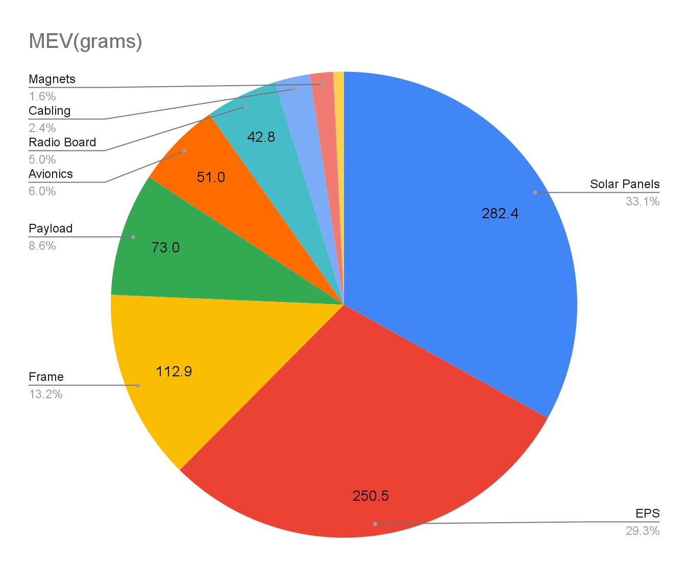
Mass Budget
Total CBE: 823 g
Total MEV: 853 g
NTE Mass: 1.3 kg
Average Contingency: 4.6%

Slide 16
Mass Budget
Components | CBE (g) | Contingency | MEV (g) | BOE
Frame | 107.5 | 5% | 112.9 | Measured - Engineering Model
EPS | 238.5 | 5% | 250.5 | Measured - Engineering Model
Radio Board | 40.8 | 5% | 42.8 | Measured - Engineering Model
Payload Board | 69.5 | 5% | 73.0 | Measured - Engineering Model
Avionics Board | 48.6 | 5% | 51.0 | Measured - Engineering Model
Solar Array PCM10A2-R11102201 | 43.0 | 0% | 43.0 | Measured - Flightware
Solar Array PCM10A1-R11102212 | 43.3 | 0% | 43.3 | Measured - Flightware
Solar Array PCM10A1-R11102211 | 44.1 | 0% | 44.1 | Measured - Flightware
Solar Array PCM10A1-R11102213 | 43.4 | 0% | 43.4 | Measured - Flightware
Solar Array & Antenna | 108.6 | 0% | 108.6 | Measured - Flightware
Coax | 6.0 | 5% | 6.3 | Data Sheet
Magnets | 12.0 | 15% | 13.8 | Estimation
Cabling | 18.0 | 15% | 20.7 | Estimation
Total weight: | 823.3 | 4.6% | 853.4 | Measured: 85%
We have a comfortable margin of 446g or over 50%. The heaviest components (solar panels) have had their final mass measured.
Notes:
wip

Slide 17
Power Board
Slide
Notes:
Josh

Slide 18
CubeSat Block Diagram
Solar Cells
CubeSat Size: 1U
NTE Size: 10cm x 10cm x 11cm
NTE Mass: 1.33kg
EnduroSat EPS
Antenna
Radio Board
Avionics Board
Payload
(Raspberry Pi)
Board
Camera
Slide
Notes:
Zoe

Slide 19
Driving (Derived) Requirements
The Board shall use five solar panels to charge the Batteries during the mission.
The Board shall provide the correct voltage power to the Avionics Board.
The Board shall provide the correct voltage power to the Payload and be able to switch the latter on and off.
The Board shall provide the correct voltage power to the Radio System.
The Board shall be able to give diagnostic reports to the Avionics Board.
The Board shall have a reasonable difference between the amount of power generated by board as compared to the usage of the satellite over a cycle.
The EPS Battery shall be compliant with Nanoracks requirements
for ISS launch.
Slide

Slide 20
Final Design
The EPS design was halted after consultation with Nanoracks over concerns about Li Ion Battery qualification, and suggested we use a qualified EPS.
We selected the EnduroSat EPS based on lowest overall cost that met or exceeded requirements. Other EPSes considered were GomSpace and Clyde Space.
This EPS has been successfully flown and Nanoracks was familiar with the product and the product was qualified for ISS launch.
Slide

Slide 21
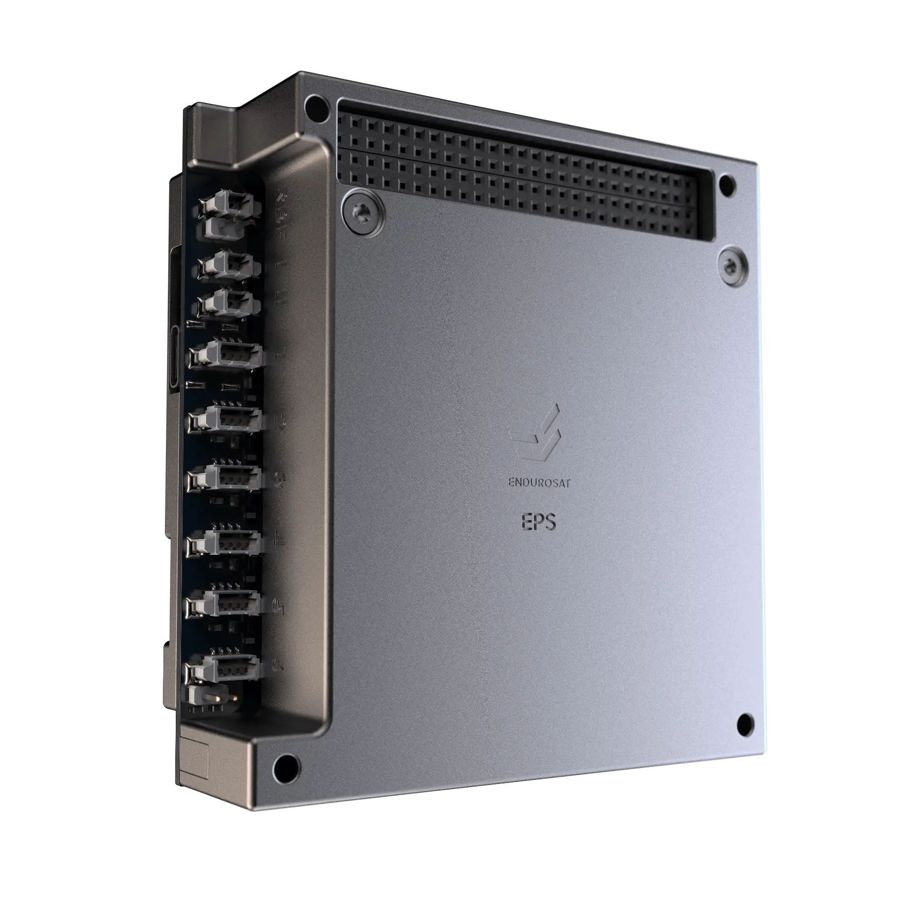
EnduroSat EPS Board Overview
Key Features
Includes Li Ion Batteries and Battery Heaters, Stores up to 10.2 Watt Hours
Draws current through three independent maximum power point trackers, from diode or’d pairs of solar cell sides.
Outputs at 5 V and 3.3 V with additional and latch up protected outputs (LUP) tripping at 2 Amps
Acceptable input voltage range from solar cells (up to 5.5 V)
Battery voltage typical 3.7 V
All outputs short circuit protected
I2C interface
Slide

Slide 22
EnduroSat Customized the EPS in These Ways…
Our design requires the EPS to be in the center of the stack. EnduroSat modified the housing and H1/H2 pins to provide a stacking connector.
EnduroSat’s base design does not include Battery inhibits
They add roller switches, which are hard-wired internally (no connectors)
EnduroSat altered the H1/H2 pinout, adding outputs to pins which were unconnected on earlier designs
Caused a conflict with our pin assignment
Made modifications to the prototypes to verify the changes
The H1/H2 definition will be revised on the flight board designs
Slide

Slide 23
Power Budget Model
Each circle represents an energy sink
The EPS has multiple internal energy sinks
Avionics
EPS
The margin is the difference between the Input Energy (square) and the sum of the energy sinks (circles)
Solar Cells
3.3V
Regulator
Diode
MPP
Battery
Radio
Battery Heaters
5V
Regulator
EPS Processor
LUP5V
Payload
Slide

Slide 24
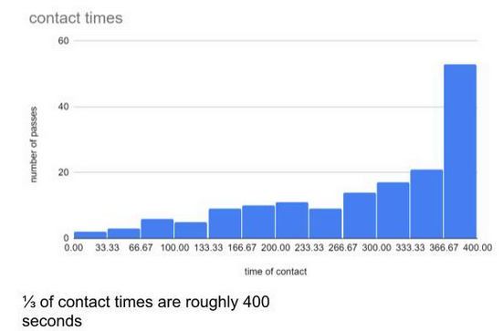
Power Budget Assumptions
Solar panels on only 5 of 6 sides.
We will not attempt a tweet unless a pass is greater than 300 seconds (5 minutes). See graph to right.
Avionics will shut down an active tweet if it takes longer than 600 seconds.
Baseline Assumption*: Input power contributed only from one side at a time But analysis of all Cubesat solar cross-section at angles provides margin.
Antenna can be switched off after it is deployed.
No energy captured from Albedo or other IR radiation sources (Earth).
Beacon time base is 100mS (time to transmit a dit).
Beacon interval is 90 Seconds.
*This simplified assumption is very conservative and we believe we get more power
Slide

Slide 25
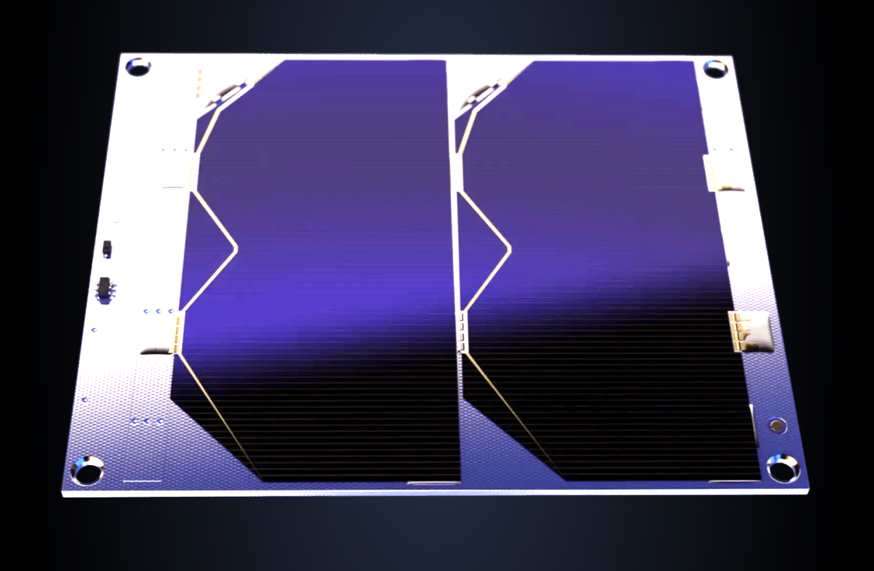
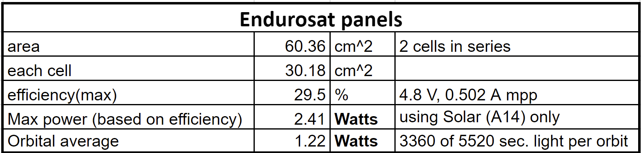
Input Side Baseline Power Budget: Solar Cell Power
Based on 1353 W/m² insolation,
power with one side illuminated broadside (2-3 sides may be illuminated - total on next slide)
EnduroSat solar cell on 5 sides of the cube
(1.22 W includes a ⅚ factor for one missing side)
Slide

Slide 26





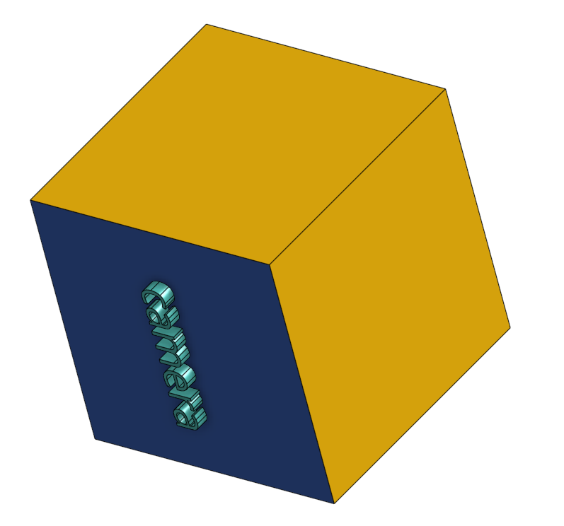
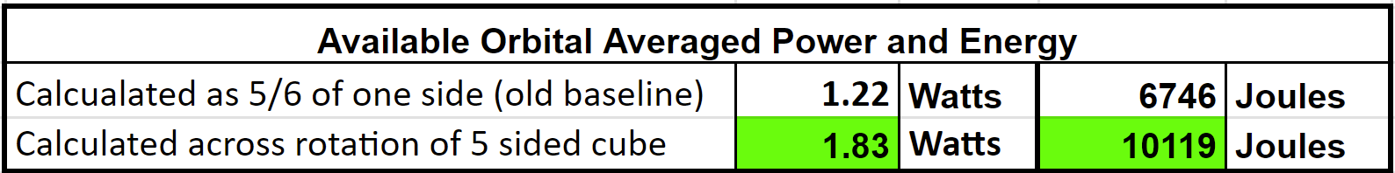
Power Budget Includes Evaluation of Total Sun the Cubesat Receives at Various Orientations
Six cases and useful illuminated area fraction
Only Solar Cell sides
With Camera side
The amount of sun received depends on the angle of the Cubesat.
Note that the camera side does not have a solar cell.
One, two, or three sides may be illuminated at any given time.
Total intercepted sunlight by a cube equivalent to that of a cross section of a sphere of equal surface area.
6s² = 4πr² equating sphere and cube area
r² = 3s²/(2π) finding r² of sphere
πr² = π * (3s²/(2π))= 1.5s² cross section of sphere
A = (⅚)*1.5s² = 1.25s² average solar cross section of 5 sided cube
.
Broadside
Area = 1x
Area = 0
Edgewise
Area = √2 x
Area = ½ √2 x
Cornerwise
Average sun exposure of randomly oriented 5 sided cube is 25% higher than broadside illumination of one side.
Area = √3 x
Area = ⅔ √3 x
Slide
Notes:
Cade

Slide 27
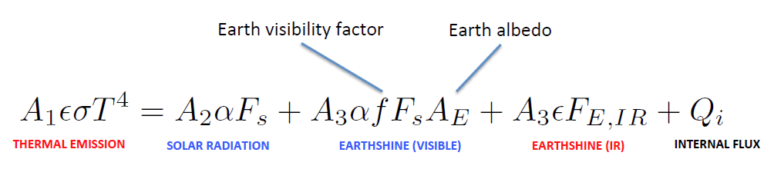
Battery Heaters
Heater energy was identified as a risk
We need to estimate the energy needed to run the Battery Heaters
Final results are pending a full thermal model of the Satellite
Heater energy estimate uses a simplified thermal model for the Satellite and EPS
We want the Batteries to be at or above 0 C
We have to supply the equivalent amount of energy is lost during an orbit
Assume there's an insulation layer around the EPS
5mm thick layer of cryogel insulation, top/bottom
EPS is thermally isolated from frame
Assume conduction from EPS top/bottom to outside through insulation
Outside temp of Satellite varies between -88 C and +35C (based on equilibrium temps)
No assumption of Battery to case conduction (i.e. Tcase=Tbattery)
Net loss estimate is about 127 joules
Rad.
Rad.
Solar panel
Insulation
EPS
Solar panel
Solar panel
Frame
Frame
Insulation
Slide

Slide 28
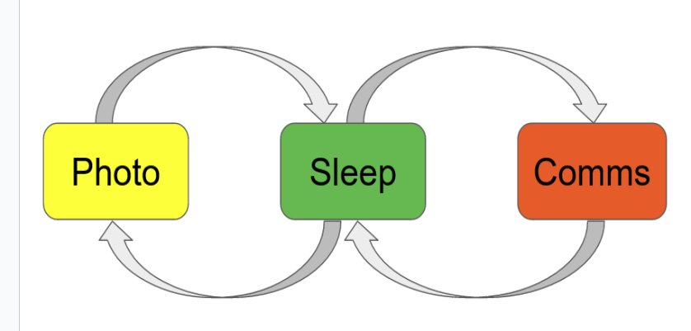
Power Budget
 | "SLEEP" | "PHOTO" | "COMMS"
 | Beacons Only | Photo w/Beacons | Tweet w/ Beacons
Number of beacons (per orbit) | 61 | 61 | 57
Input Energy | 10119 | 10119 | 10119
Input Diode | 464 | 464 | 464
MPP Charger | 965 | 965 | 965
Net input to battery | 8689 | 8689 | 8689
Heaters | 127 | 127 | 127
EPS | 408 | 408 | 408
Payload | 0 | 342 | 855
Radio (receive) | 1156 | 1156 | 1156
Radio (beacons) | 1392 | 1392 | 1301
Radio (tweet) | 0 | 0 | 883
Avionics | 847 | 847 | 847
Net out of battery | 3930 | 4272 | 5578
watts(OAP) | 0.712 | 0.774 | 1.010
Net Excess Energy | 4759 | 4417 | 3112
The budget is based on system states representing a day in the life of the Satellite
Beacon (beacons only)
Photo (photo w/ beacons)
Comms (tweet w/ beacons)
MEV Net Excess Energy per Orbit | 3532 | 3121 | 1674
Largest risk remains heaters
Slide

Slide 29
Next Steps
Consider replacement of 3.3V regulation scheme for lower overhead current
Complete measurements of required currents
Verify time taken to tweet/take a photo*
Revise H1/H2 definition pins
*Timeline affects how much energy is needed to tweet
Slide

Slide 30
Currently Working On? Going into Flight Model Build…
The EnduroSat EPS 3.3V regulator is extremely inefficient at our current level
Considering placing linear 3.3V regulators on Avionics and Radio Boards and regulate down from the raw Battery voltage
Slide

Slide 31
Avionics Board
Slide

Slide 32
CubeSat Block Diagram
Solar Cells
CubeSat Size: 1U
NTE Size: 10cm x 10cm x 11cm
NTE Mass: 1.33kg
EnduroSat EPS
Antenna
Radio Board
Avionics Board
Payload
(Raspberry Pi)
Board
Camera
Slide
Notes:
Zoe

Slide 33
Driving (Derived) Requirements
The Avionics Board shall…
Keep track of time using a real time clock
Formulate the beacon message
Determine the time at which the CubeSat should transmit a beacon message
Communicate the beacon message to the Radio Board at the time determined for beacon transmission
Collect and process power measurements from the Power Board
Generate the Power Board beacon character based on Power Board performance measurements
Determine the Avionics beacon character pertaining to the Avionics Board state of health
Receive and process uplink commands via the Radio Board
Be in control of the power state of the Payload Board
Be able to communicate what state the Payload Board shall be in when it beats what.
Be able to acknowledge a received command
Be able to check GPIO shutdown pin
Protect itself from software bricks using the watchdog tick
Give information on the status of the other boards
Give telemetry information.
Slide

Slide 34
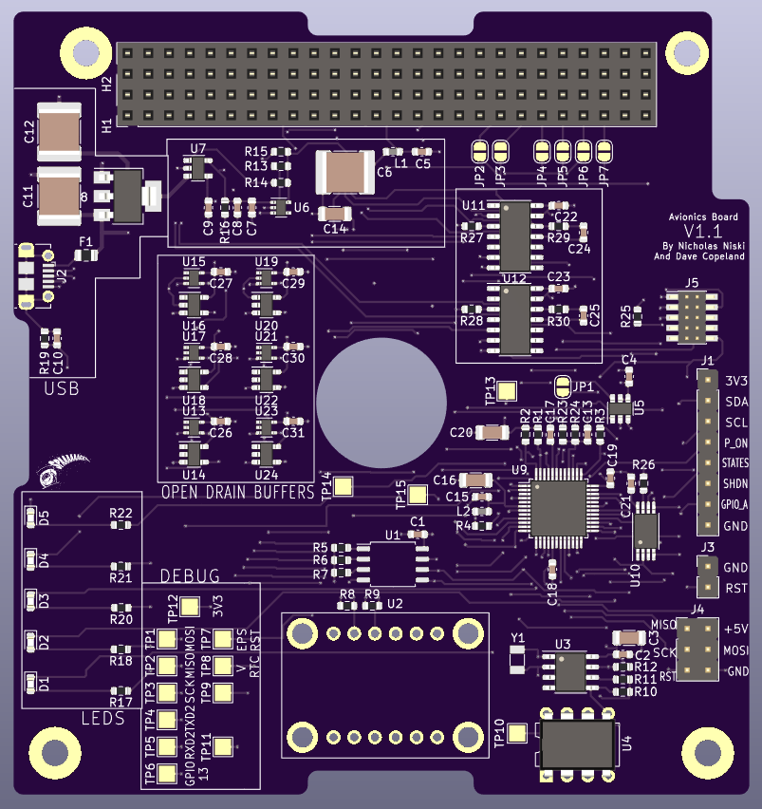
Avionics Diagram - Connections Inside the Board
Watchdog chip TPS3813-Q1
74LVC1 Open Drain Buffer x6
SN74B3Q3306A I²C Switch
Reset line
Watchdog tick
GPIO lines
Fram CY15B256J
I²C
Microcontroller
Samd21
TxD x2
GNC
Adafruit MPU 6050
SN65HVD70D Serial Drivers x2
RxD x2
I²C
USB Line
Real time Clock
DS1337
USB Port
page
34
Notes:
Nicholas

Slide 35
Avionics Diagram - Connections to Other Boards
To/From Payload
To/From Power Board
Payload On
I²C
Avionics
RxD
3.3V
TxD
To/From Radio Board
RxD
Gpio shutdown
TxD
Gpio States(Tweet and Picture)
I²C
I²C
Payload On 0=on 1=off
Shutdown 1=shutdown possible 0=Pb on
States 1=tweet 0=photo
page
35
Notes:
Nicholas

Slide 36
Final Design
The Flight (V2.0) version of the Avionics Board will include
Revised Hardware that complies with New EnduroSat Header Definition.
New Graphics allows for easier identification of Regions on the Board and Other Headers and Test Points.
Original THT LEDs replaced with New SMD LEDs.
Pull Up Resistors added to Open-Drain Buffers.
Slide

Slide 37
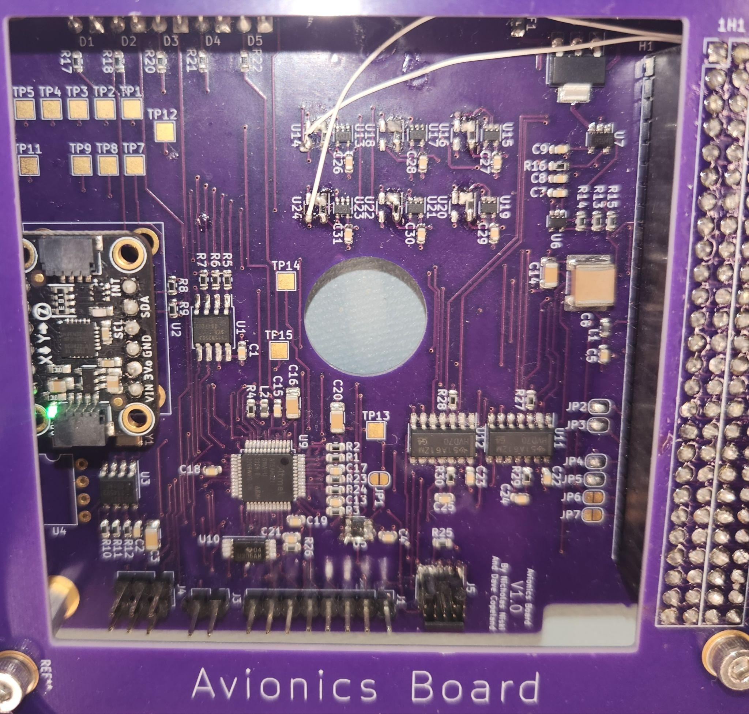
Avionics Board V1.0
The Avionics Board V1.0 was very successful, with no major hardware issues present.
Minor issues did present, for example, the open drain drivers required pullup resistors to prevent Payload from accidentally starting up on boot.
Slide

Slide 38
Code
Made the first prototype codebase to test the software for different components
Made the second prototype codebase that started to integrate the different parts of the codebase together
Made the third prototype codebase which fully integrated the parts of the codebase
Flight Model will get rid of unnecessary code that was used for testing and try to optimize the code as much as possible
Slide

Slide 39
Code cont.
Codebase had a few main parts to it
Code for the different hardware components
Watchdog timer
Ds1337 real time clock
Antenna
FRAM
Communications with other CubeSat Boards
IMU to detect the orientation of the Satellite
Code for the different commands
Code for the beaconing
Code for determining photo time
Code for controlling Payload
Code for receiving commands from Radio
Slide

Slide 40
Prototype 2 Test Results
Avionics Board header pin reassignment tested successfully (no collision issues)
Open-Drain Buffers pull down resistors functioned as expected (Payload did NOT boot up on power on)
Slide

Slide 41
Currently Working On? Going into Flight Model Build…
Fixing Issues: Header pin assignments changed in response to allow synergy with the EnduroSat EPS. Pull-up resistors connected to open-drain buffers to prevent Payload from booting on power on.
Adding helpful graphics: Drawing boxes around different regions of the Board to help identify circuits and other test points and headers
Replacing LEDs: Non-functioning THT LEDs replaced with SMD LEDs, and resistors replaced to obtain proper voltage drop
Slide

Slide 42
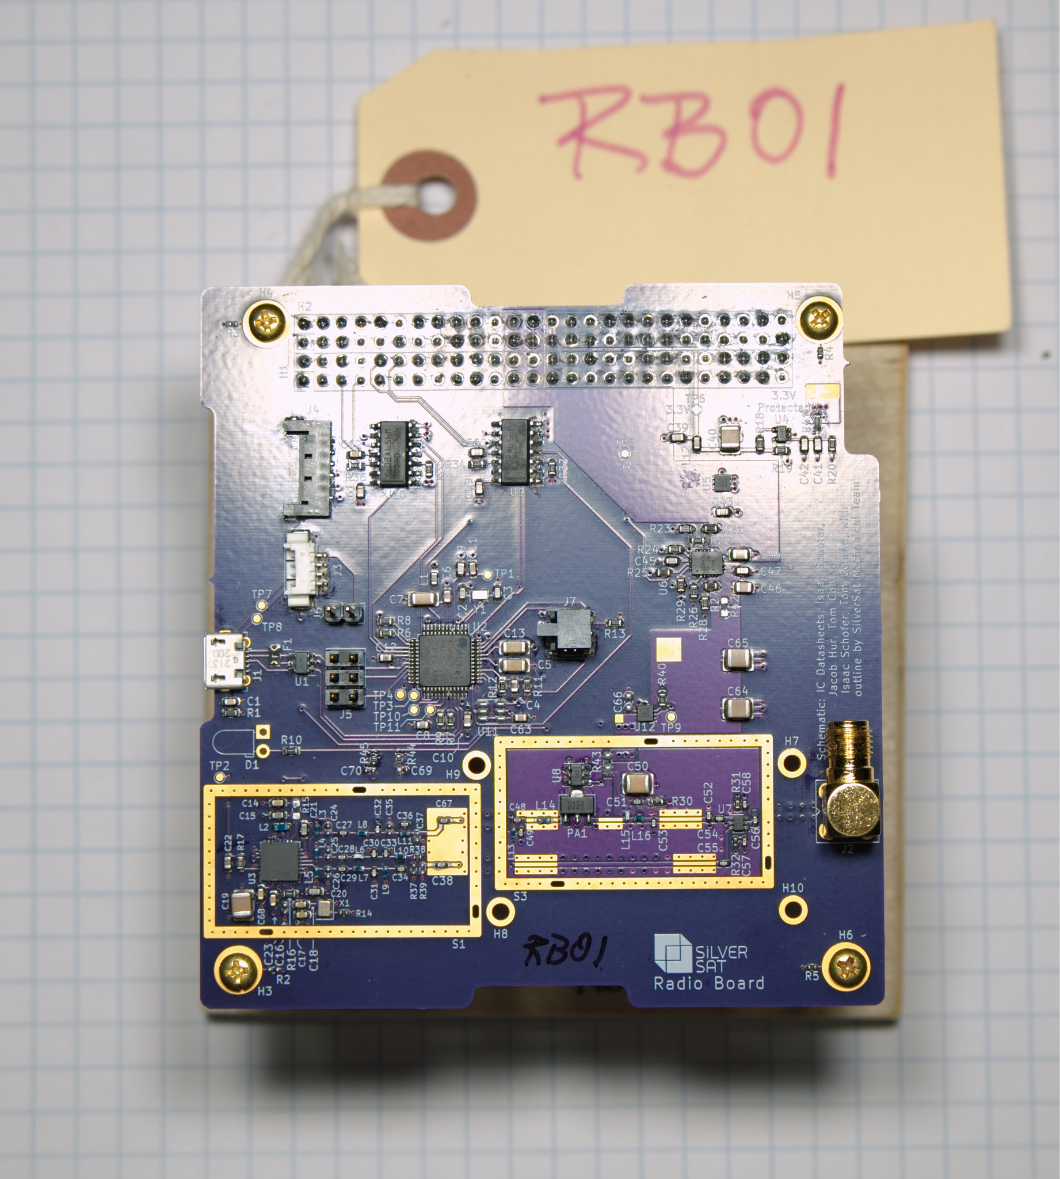
Radio Board
Slide
42

Slide 43
CubeSat Block Diagram
Solar Cells
CubeSat Size: 1U
NTE Size: 10cm x 10cm x 11cm
NTE Mass: 1.33kg
EnduroSat EPS
Antenna
Radio Board
Avionics Board
Payload
(Raspberry Pi)
Board
Camera
Avionics and Payload UARTs pass through H1/H2. The Antenna has a dedicated connector.
Slide
Notes:
Isaac

Slide 44
Driving (Derived) Requirements
The Radio Board shall…
✅ provide an Internet connection to and from Avionics Payload
✅ provide basic status for the beacon
✅ tx. beacon and rx beacon info from avionics every one and a half minutes, but no more than 10
✅ transmit a beacon using Morse code every one and a half minutes
✅ receive beacon information from Avionics
✅ receive signals from the ground
✅ transmit signals to the ground
transmit data using AX25.
✅ exchange data with the rest of the CubeSat using KISS
✅ send commands from the ground station to avionics.
✅ receive commands
✅ communicate with Avionics using the KISS protocol
✅ transmit at a frequency near 438 megahertz (operating range 400 to 520 MHz)
✅ receive signals at a frequency near 438 megahertz
❌ transmit with an output power of no less than 30 dBm (28 dBm measured)
✅ transmit signals with a standard data speed of no less than 9600 baud
✅ receive signals with a standard data speed of no less than 9600 baud
exhibit a noise figure of no greater than 2 dB (✅ ground only)
✅ exhibit an implementation loss of no greater than 3 dB
✅ have a mass of no greater than 112.8 grams (40.77 g measured)
✅ consume no more than 2.574 watts while transmitting (2.37 watts measured)
❌ consume no more than 82.5 milliwatts while receiving (90 mW measured)
✅ receive data from the raspberry pi
✅ receive configuration commands
✅ be fast enough to carry a full TCP/IP connection, but still conserve power and bandwidth
page
44
Notes:
Isaac

Slide 45
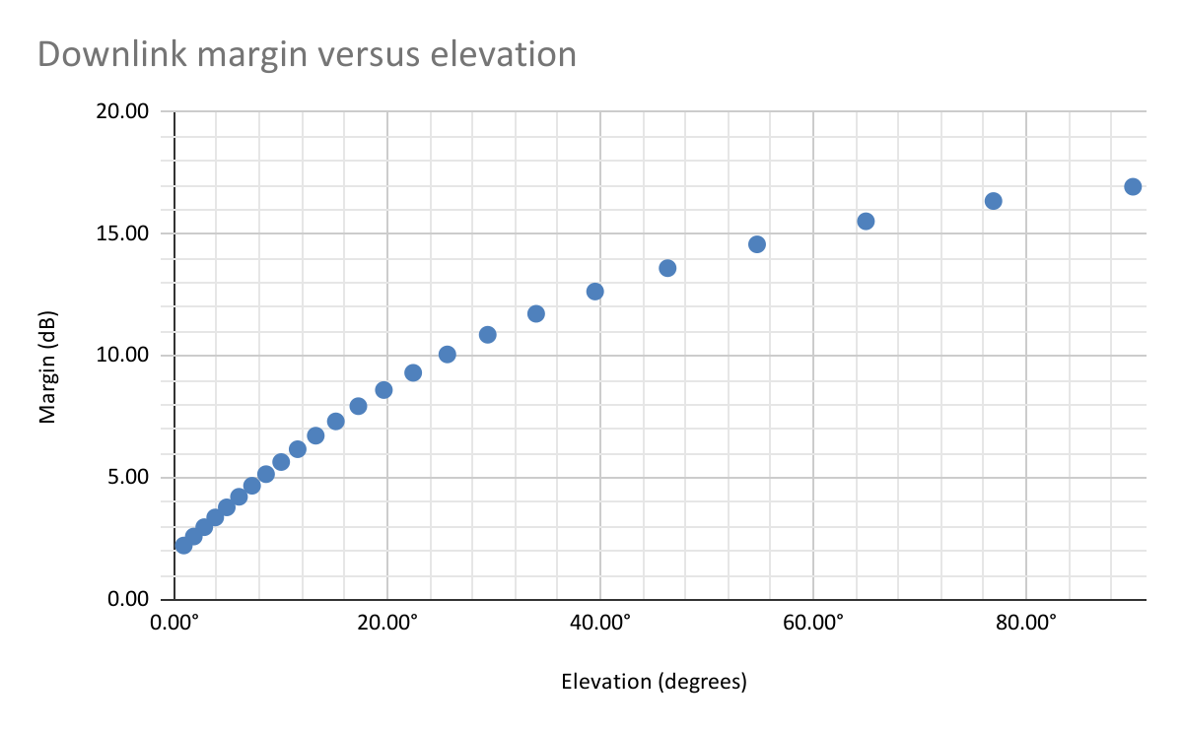
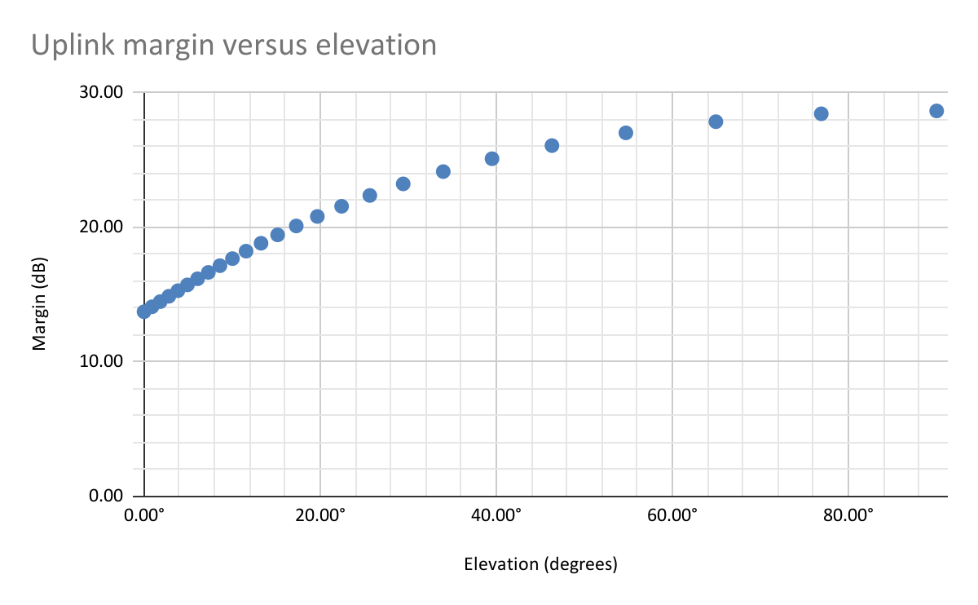
Link Budget
Downlink
Transmitter Output Power (dBm) | 28.00
Cable Losses (dB) | -0.50
Antenna Gain (dBi) | 0.00
Output EIRP (dBm) | 27.50
Receiver Power (dBm) at 1 570 km (12.09°) | -110.19
Margin (dB) at 1 570 km (8.97°) | 5.78
Uplink
Transmitter Output Power (dBm) | 40.00
Cable Losses (dB) | −1.00
Antenna Gain (dBi) | 15.5
Output EIRP (dBm) | 52.30
Receiver Power (dBm) at 1 570 km (12.09°) | −98.69
Margin (dB) at 1 570 km (8.97°) | 17.28
Required BER = 10⁻⁷
Slide
Notes:
Isaac

Slide 46
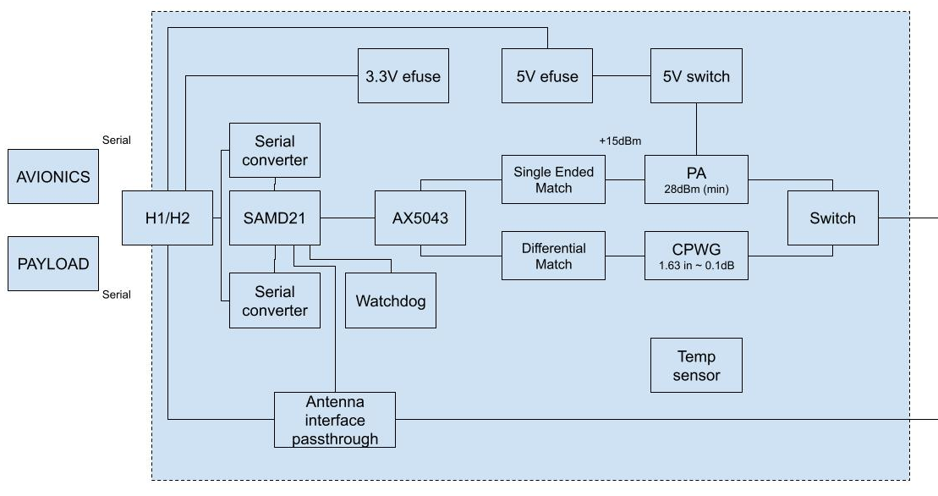
Reference: Satellite Radio Block Diagram with Detail
Proto had no major hardware issues.
Revisions for final will include:
An attenuator was added to the receive path, but it should be on the transmit path
Power amplifier was saturated
Slide
Notes:
Isaac

Slide 47
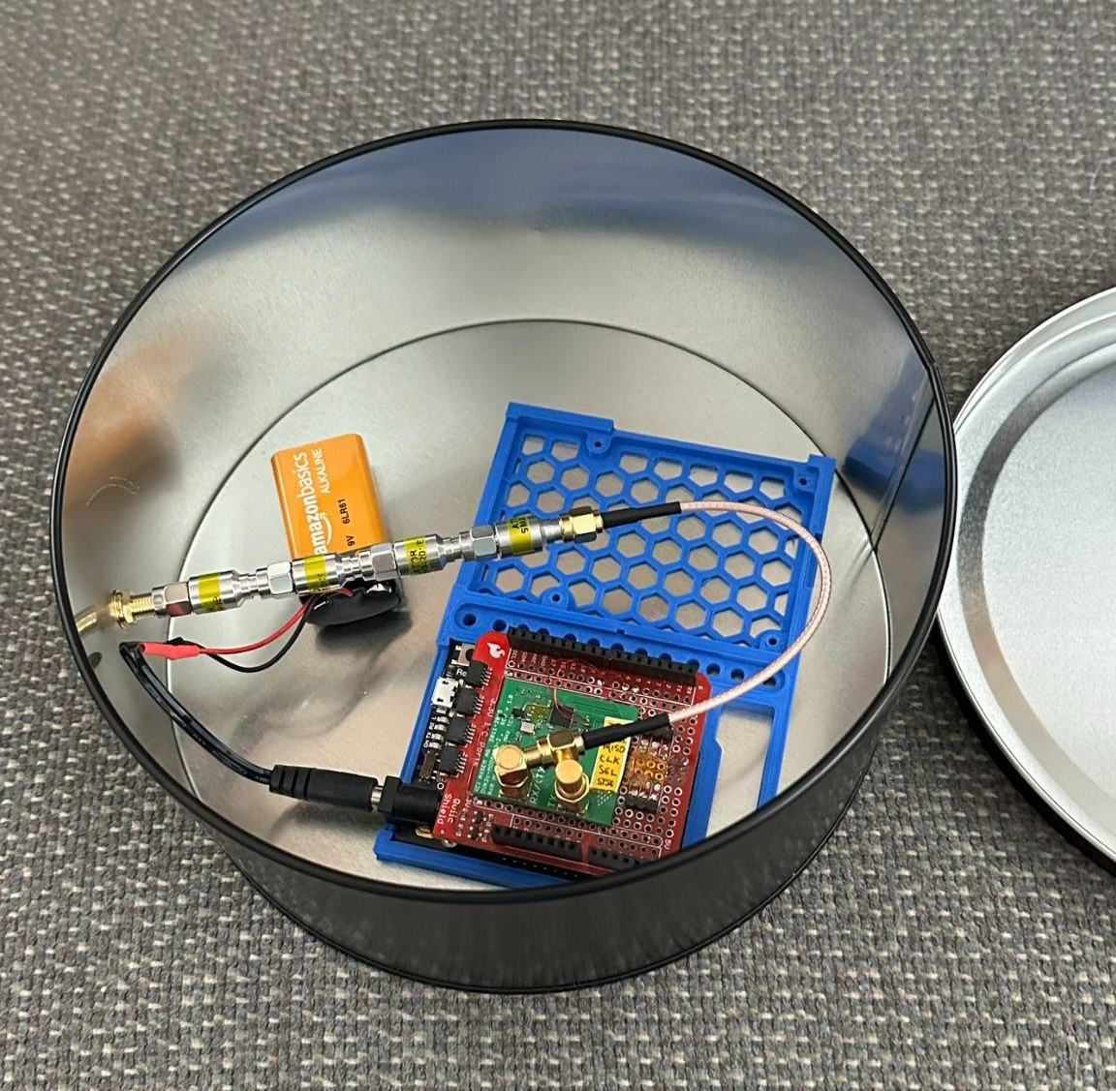
Bit Error Rate Testing
The variable attenuator was adjusted to provide between -114 to -128 dBm
(LNA included in the second test)
0 dBm
0 to 30 dB
24 dB gain
50.7 dB 60 dB
Transmitter
nooelec LNA
SilverSat Radio Board
Laptop
DC block
DC block
Shielded box
“Cookie tin shielded enclosure”
Slide
Notes:
Cade

Slide 48
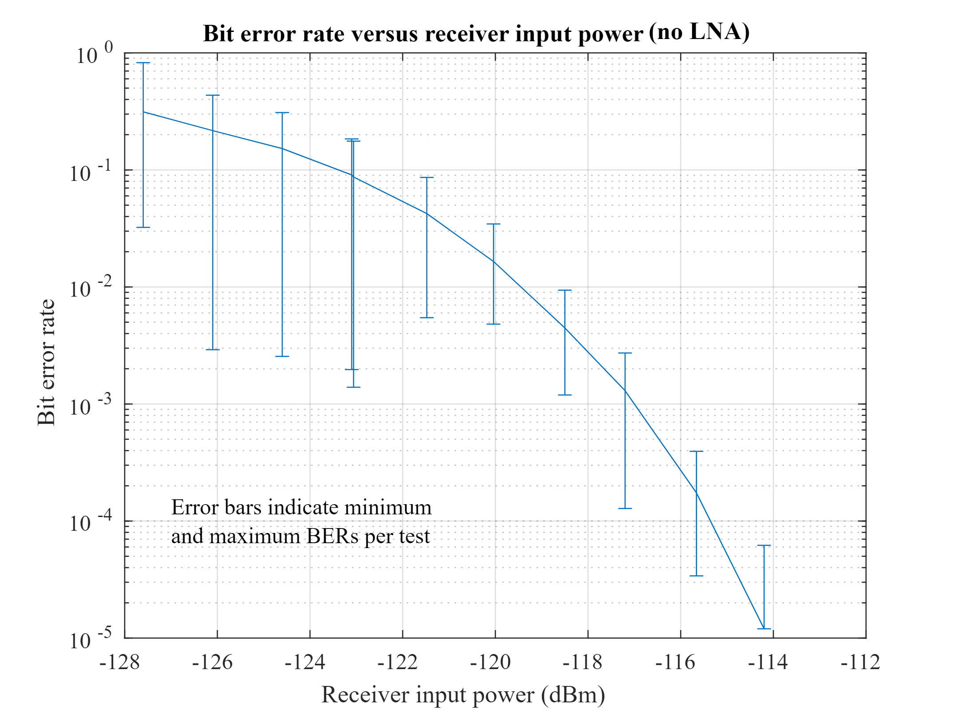
Bit Error Rate Testing cont.
But how well does our receiver perform?
Given a required Eb/No of 13.3dB @ 10⁻⁵ BER (Non-coherent FSK), and using the AX5043 receiver BW (14.4 KHz), the minimum detectable signal should be -119 dBm (0 dB NF).
Our measurements show a 5dB deviation, split between receiver front end noise and implementation losses.
Subsequent measurements with an external LNA showed an improvement between 4 to 5 dB.
These are the results
without an LNA.
Slide
48

Slide 49
Things We Might Want to Add
Improving Link Margin
We’re barely getting +28.5dBm right now (should be 30)
current PAE is roughly 28% (should be closer to 50), but haven’t played with tuning
Can improve to +32-34 dBm at cost of more DC power draw (at peak output)
4dB improvement on downlink margin where we’re tightest
GRF5504 or HMC453 (drop in replacement)
If PAE numbers are to be believed, this would cost an additional 700 J per tweet
Add an LNA
The decision is to include the LNA on the ground side, but probably not include the LNA on the satellite
This isn’t the link that is power limited and more likely to have strong in-band interferers, but there is room in the power budget
We would need to add/design a front-end filter
MAX2650, 0.7dB NF, 3.5mA typ @ 3.3V
Filter for LNA
SAW based filter, TA1808A, 440MHz, 20MHz BW, 2.4dB IL
Or design our own ;)
May want to have a filter regardless due to adjacent channel interference
Still need to do a proper survey once we have a frequency
Secondary radio
Adds full duplex and redundancy
Needs another 435 to 438 MHz frequency; a request AMSAT may not grant
Potentially include an Iridium SBD module for AMSAT compliance, but that will require an additional Antenna
All items, except beacon characters, require approximately six months to implement. LNA and filter require frequency allocation before they can start.
Slide
Notes:
Isaac

Slide 50
Payload Board
Slide
50

Slide 51
CubeSat Block Diagram
Solar Cells
CubeSat Size: 1U
NTE Size: 10cm x 10cm x 11cm
NTE Mass: 1.33kg
EnduroSat EPS
Antenna
Radio Board
Avionics Board
Payload
(Raspberry Pi)
Board
Camera
Slide

Slide 52
Driving (Derived) Requirements
Input/Output
Board Power switch (Input from Avionics, +5VLUP from Power)
Photo/Tweet (Input from Avionics)
Running/Shutdown (Output to Avionics)
Differential Serial (Input/Output Radio)
Take Photo
Switch RPi Serial to Camera****
Use Camera to take photo
Save photo to filesystem
Send Tweet
Switch RPi Serial to Radio****
Set up network, run startup scripts
Login to Twitter and tweet text or photo if present
Remove photo if successful
**** New since PDR
Slide
Notes:
AlexG

Slide 53
Payload Board - Connections
To and From Radio
From Battery Board
RxD
Payload
5v
TxD
To and From Avionics
GPIO States (Tweet and Picture)
GPIO Shutdown
Payload On
I2C Data SDA
I2C Clock SCLK
Slide
Notes:
AlexG

Slide 54
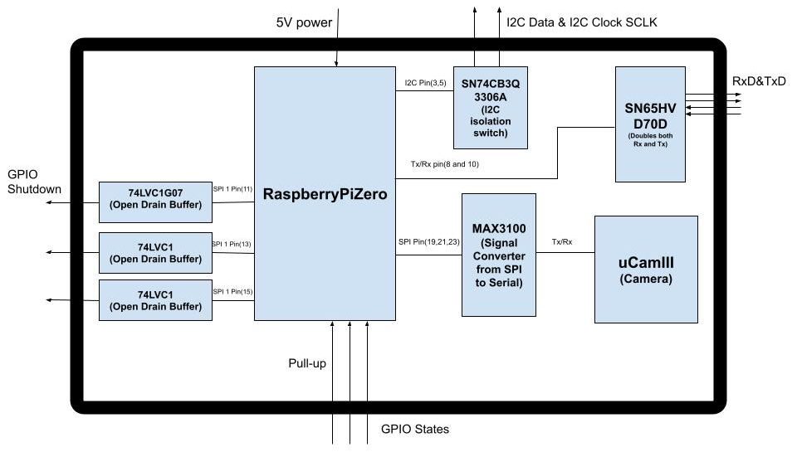
Payload Board - Block Diagram
Payload On
+5V Power
I2C Data & I2C Clock SCLK
+5V
+5V Power Switch
Tx/Rx
74HC157 (Serial switch)
74lVC1
(Open drain buffer)
74lVC1
(Open drain buffer)
Radio/ Camera Pin (26)
74lVC1
(Open drain buffer)
Slide
Notes:
AlexG

Slide 55
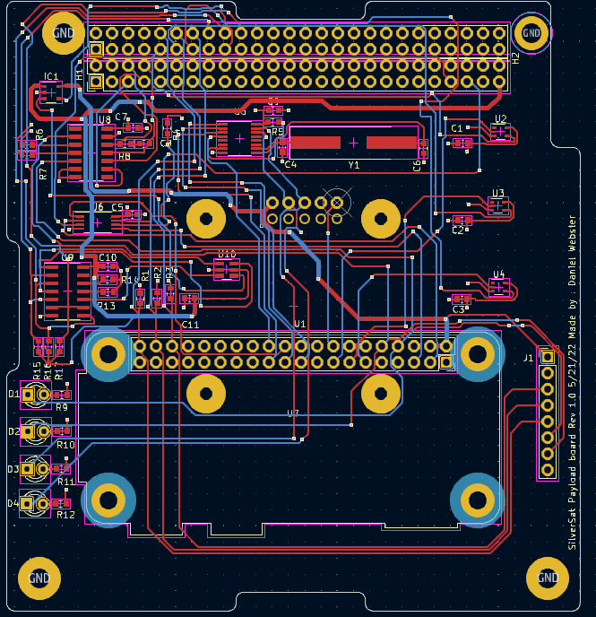
Payload Board
- PCB Layout
Slide
Notes:
AlexG

Slide 56
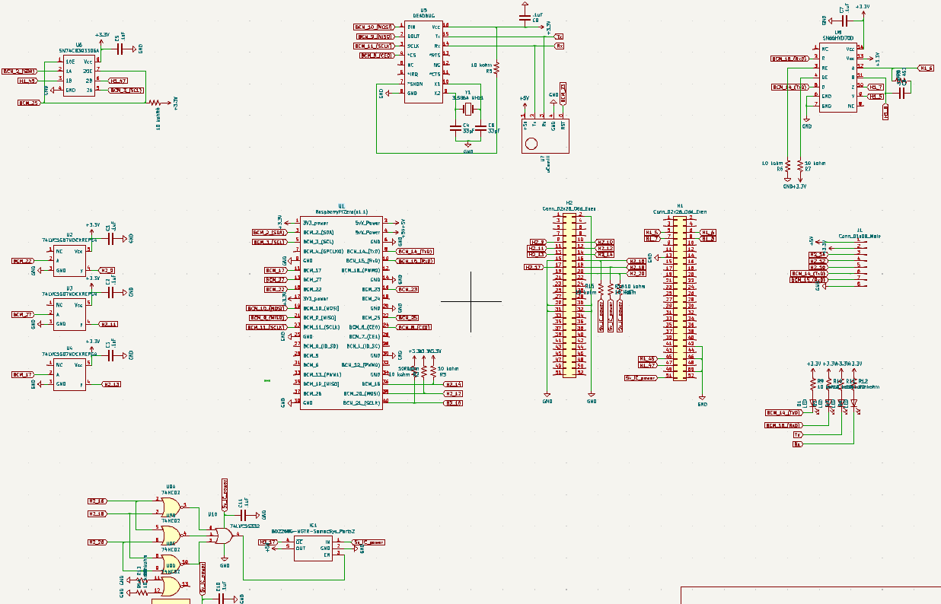
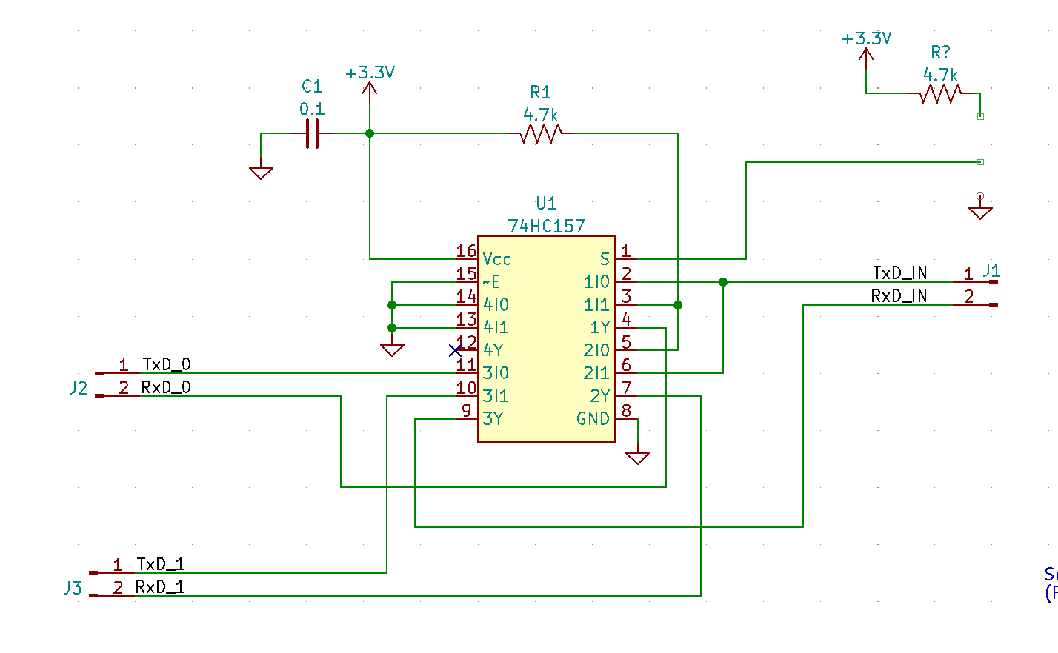
Payload Board - Schematic
Max3100 &
uCAM-III
Transceiver
I2C Bus Switch
Side Header
Open Drain Buffers
RPi
LEDs
Headers
Power Switch
Serial Switch
Slide
Notes:
AlexG

Slide 57
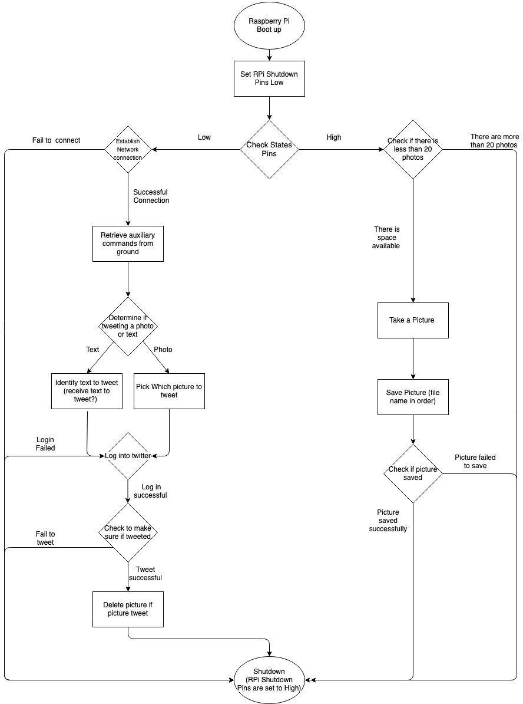
Payload Board - Software Flowchart
Slide
Notes:
AlexG

Slide 58
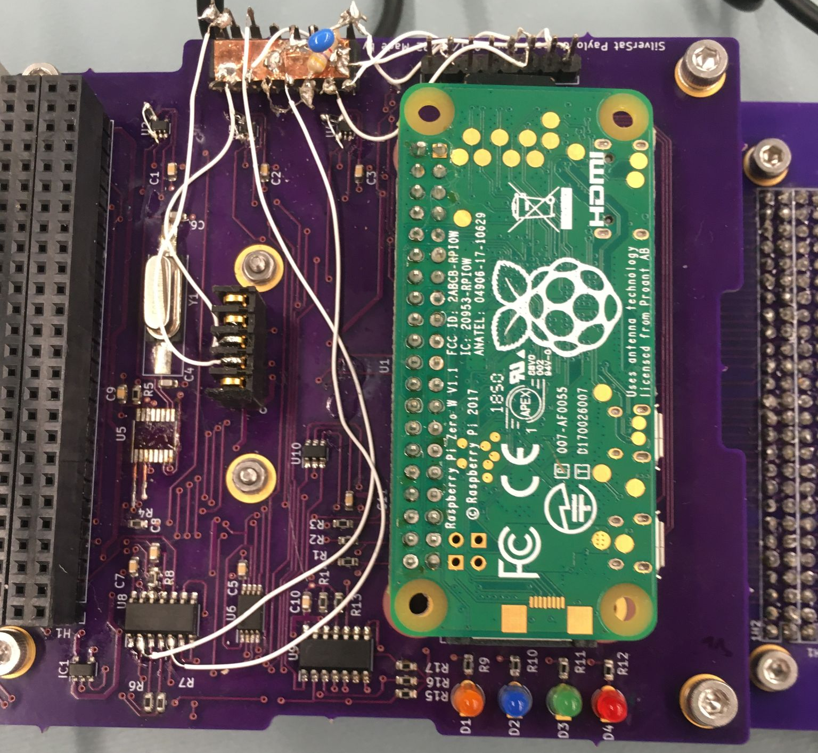
Payload Board - Prototype 2
Slide
Notes:
AlexG

Slide 59
Payload Board - Prototype 2
Serial Switch (Dead Bug)
Camera (uCAM-III)
Side Header
Transceiver
Raspberry Pi
Slide
Notes:
AlexG

Slide 60
Payload Board - Software Infrastructure
Configuration system in github for Raspberry Pi (Payload/Ground)
Simple, reliable, repeatable, named setups for Raspberry Pi
Swappable Python modules for simple switching of components
Camera connection (SPI/Serial); Twitter post (vs alternatives), etc.
Mini File Server (MiniFS) on Ground for file upload/download to Satellite
Auxiliary startup script from Ground, logfiles to Ground
Twitter alternatives - Reddit or MiniFS
MiniFS (on Ground) can be patched, post to multiple sites
Consistent interface for Satellite regardless of destination
Slide
Notes:
AlexG

Slide 61
Payload Board - Prototype 2 Test Results
Payload Board demonstrated its ability to:
Avionics signaling
Correctly powers up when Power On lines high
Correctly interprets PHOTO/TWEET on States lines
Correctly sets RUNNING/SHUTDOWN on Shutdown lines
Take a photo
Sets Serial switch, syncs with camera, saves photo in filesystem, increments photo counter
Establish network connection,
Sets Serial switch, runs network setup commands, pings the ground, sets the clock, downloads auxiliary startup script, executes code, and sends upload logs to ground
Tweet
Checks for a photo to tweet, text tweet if no photo, if there is a photo tweet deletes photo
Slide
Notes:
AlexG

Slide 62
Payload Board - Prototype 2 Test Results cont.
Current Draw
Sleep mode: 0 current draw
RPi on: 200 to 300mA
Running Time
Bootup: ~50 seconds
Take photo: ~90 seconds
Tweet: ~5 minutes
Total Power Usage Estimates
Photo: 140 Joules
Tweet: 350 Joules
Slide
Notes:
AlexG

Slide 63
Currently Working On? Going into Flight Model Build…
Redesign of Payload Board PCB for serial switch
Low-power Satellite Raspberry Pi configuration
Turn off HDMI, WiFI, etc.
Determine total power consumption for photo and tweet modes
Depends on size/complexity of photo
Easily change tweet text from Ground, and
Implement tweet text placeholders for Payload status values
Slide
Notes:
AlexG

Slide 64
Ground Station
Slide
64

Slide 65
Driving (Derived) Requirements
The Ground Station shall...
... transmit and receive Radio signals
The Ground Station's computer shall host the Satellite's Internet connection
... use tracking software to locate the CubeSat
... send and receive commands
... send and receive data in a data format
... receive the Satellite's beacon and status characters
... use the location of where we want the CubeSat to be when we take a picture, predict when it will reach it, and send the picture time to the Satellite
... receive and filter through public requests for a location of the picture
A person, either a licensed Amateur Radio Operator or under the supervision of an Amateur Radio Operator, shall be at the control point
... consist of the components necessary for proper and sufficient operation, including, but not limited to, those found in the Ground Station block diagram
... send a consistent ping up to the CubeSat to start the process of connecting to the CubeSat
page
65
Notes:
Isaac

Slide 66
Ground Station Software
Ground Station Software Establishes Flask Server
Listens and connects with GPredict to get Radio Doppler Frequencies
Provides Interface for Commands
What does it do?
Enables Commands
Display Status
Rapid Entry of Commands
Controls Radio Frequency
Future Tasks
Implement and Test Antenna Control
Waits for Input Request/ Submission
On Input,
Creates/Sends a Request to Server
Server Converts Data and Sends through Radio
Listens for Response Transmissions
Decodes and Writes Responses on Interface
Slide

Slide 67
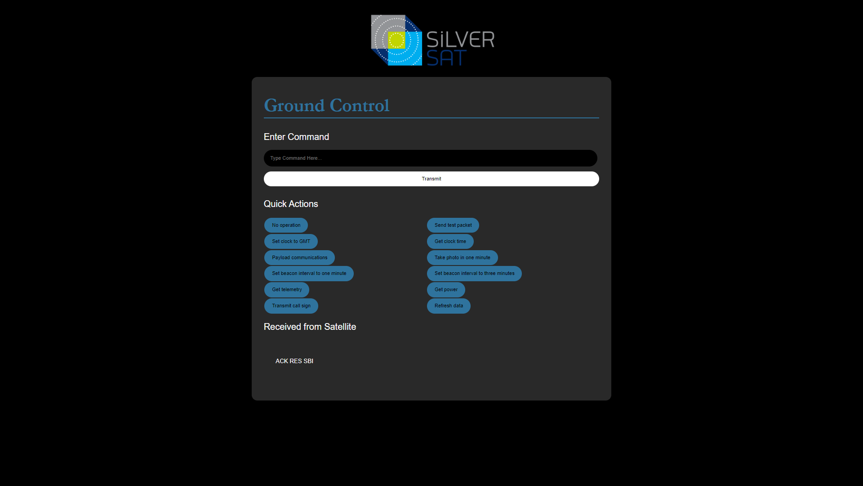
Slide

Slide 68
Big Picture
Mounted near Antenna for lowest loss
Local
Network
(to internet)
Tx, Rx & Sw.Cntl
Ground Station
(inside)
Ground Station
(outside)
Antenna
Antenna
Positioner
Ground Station
Controller
30 meters?
~ 1 meter
Location: Goddard Amateur Radio Club clubhouse, Glenn Dale, Maryland
HAAT: −15×10⁻¹ m* plus tower height
* United States Federal Communications Commission (2016, January 21). Antenna Height Above Average Terrain (HAAT) Calculator, output for 39°00’42.36‘‘N, 76°50‘21.33˘W. https://transition.fcc.gov/fcc-bin/haat_calculator?dlat=39&mlat=0&slat=... Accessed May 24, 2022 12:00 PM
Slide
Notes:
isaac

Slide 69
Ground Station Inside Segment Detail
Power Supply
13.8V 15A min
GS Transceiver PCB (all one board)
13.8VDC to 5VDC
X mm
Plug
USB
Type B
or Micro
To
Outside Switch
Cable
RG59
100 ft.
2x F
GROUND
PC
FTDI
FT232RNL
Switch control (5x AC gate driver)
F
Driver Amp
Pout 36dBm (min)
G ~ 19dB
PA
47dBm(min)
Toptek PA-80u
G=13dB(min)
NF = 2.5dB
Debug Port
USB
Micro
Cable LMR600
100 ft. ~ 1.7dB
2x SMA
Single Ended Match
SMA
Cable
SAMD21
AX5043
13.8V
Differential Match
SMA
Cable LMR600
100 ft. ~ 1.7dB
2x SMA
Antenna Controller
RT-21 AzEL
115VAC -3A
230VAC - 1.5A
RPi
Zero 2 W
Pi attached by 40 Pin header:
Serial, 5V (to Pi), 3V3 (from Pi), optional GPIO
Alternative: RPi 4 or 5 attached via ribbon cable
To Antenna Rotator
RPi Zero 3V3 can source 500mA
Slide
Notes:
Miguel, Isaac
The yellow block is the main radio transceiver and interface for the ground station.
It is based on the Satellite radio board, except that the space specific parts have been removed.
The RF output switch was also removed, and has been replaced with separate receive and transmit connectors.
The board can optionally integrate a raspberry pi, that talks to Twitter

Slide 70
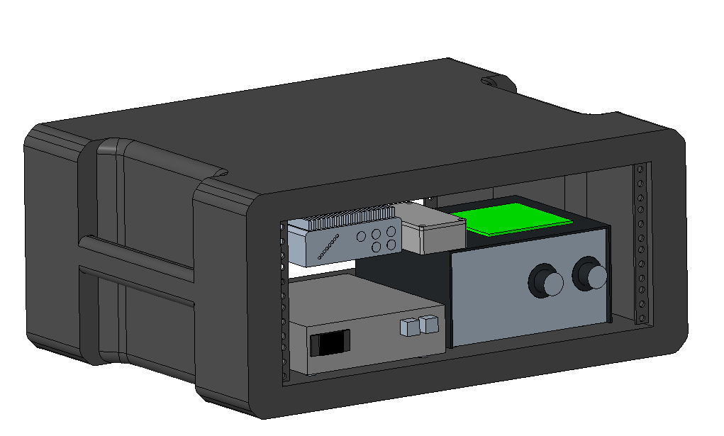
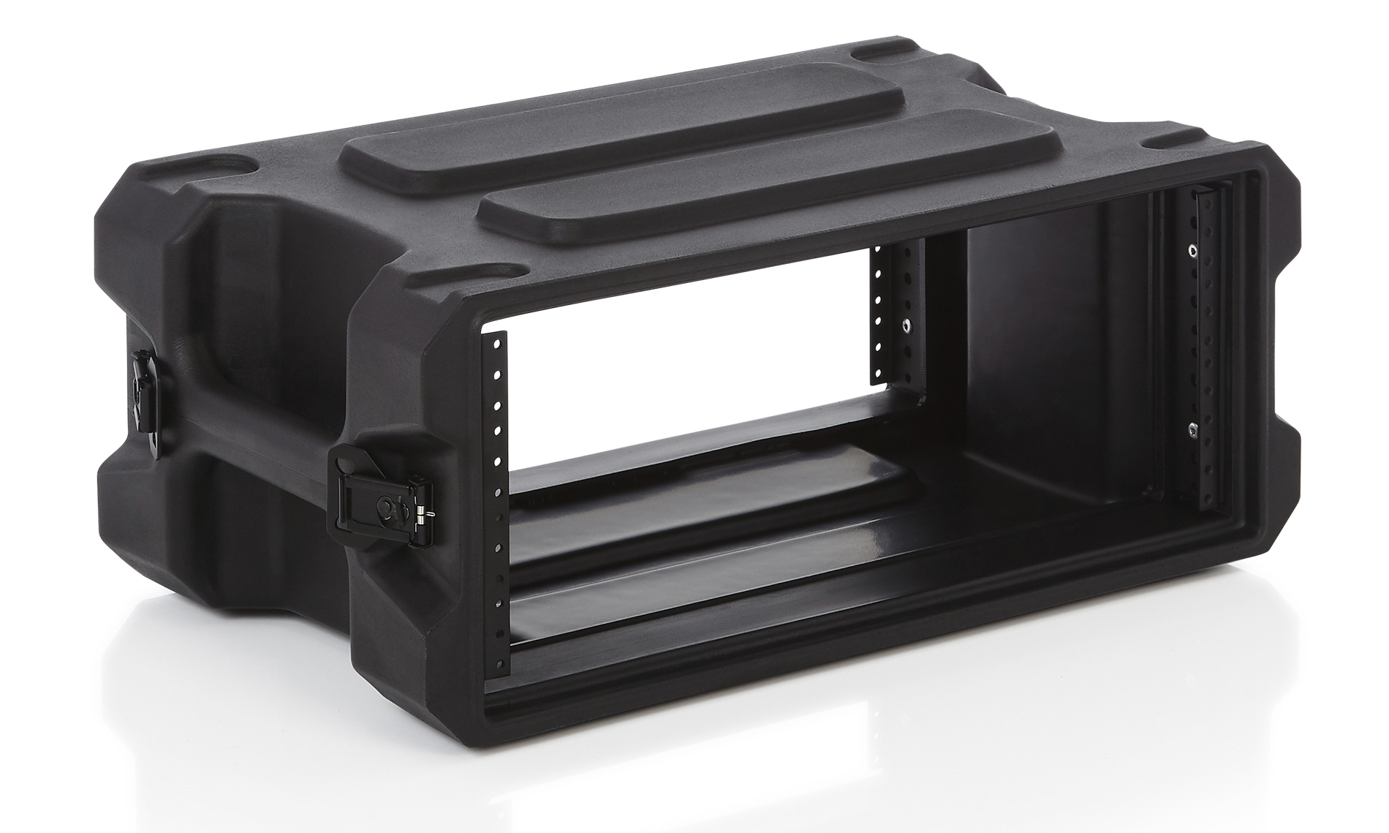
Indoor Ground Station Mechanical Design
Indoor Box: Compact, easy to transport, provides enough space for circulation
GS Transceiver PCB
Driver Amp
Power Amp
Power Supply
Antenna Controller
4U, 13″ Deep Molded Audio Rack
G-PRO-4U-13
48.26 x 34.29 x 18.29 cm
Indoor Ground Station CAD Model
Slide
Notes:
Aidan

Slide 71
Top-Level Diagram (Outside Segment)
From Transceiver
F connector
Switch control
12-15V, 250mA
5V, 40mA
From PA
N
FILTER
IL=0.15dB
430-440MHz
Cable
0.1m ~ 0.14dB
2x SMA
LMR100
Switch
IL=1dB(max)
Pin = 46dBm(max)
ISO = 31dB (min)
Cable
10 ft ~ 0.2dB
2x N
LMR600
Antenna
M² 436CP16
13.3dBi gain
13.8V to 5V
Cable
0.1m ~ 0.14dB
2x SMA
5V, 95mA
LNA
0.4dB NF,
G=18dB
IP3 +39.7dBm
Pin, max = 21dBm (mini-circuits)
Cable
0.1m ~ 0.14dB
2x SMA
LMR100
To Transceiver
N
Bias Tee
FILTER
IL=0.15dB
430-440MHz
Slide
Notes:
isaac

Slide 72
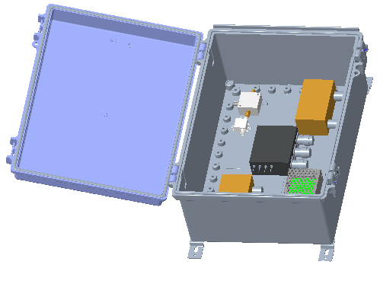
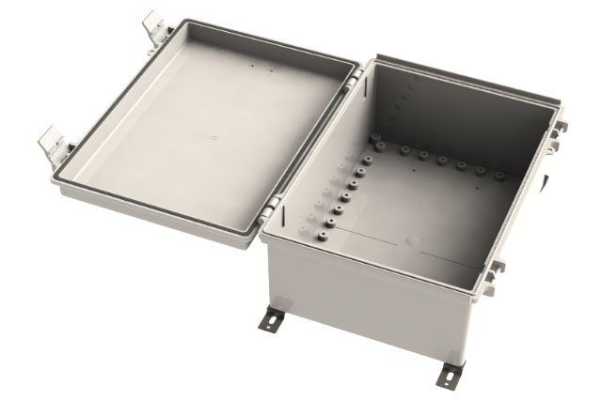
Outdoor Ground Station Mechanical Design
Outdoor Box: Waterproof, components are easily accessible
DC Converter
LNA
Switch
Filters
WH-22-03 Hinged Nema Enclosure
34.9 x 24.9 x 14.9 cm
Outdoor Ground Station CAD Model
Slide
Notes:
Aidan

Slide 73
Activities Since PDR
Added more licensed operators: we have 5 Students and 3 Mentors with licenses. Two more Students and 1 Mentor plan to take the exam in February
Obtained Club Call sign: KC3VVW*
Submitted AMSAT coordination request
* United States Federal Communications Commission (2023). ULS License: Amateur License - KC3VVW - Silversat. https://wireless2.fcc.gov/UlsApp/UlsSearch/license.jsp?licKey=4748227 Accessed 29 January 2024.
Slide
Notes:
Isaac

Slide 74
Currently Working On? Going into Flight Model Build…
Radio Board: Our ground transceiver
Finalizing the Indoor and Outdoor Ground Station Mechanical Design
Slide
Notes:
Isaac

Slide 75
Beacon Box
Requirements: External Antenna connect CW mode Min range of 420-440 MHz Output Demodulated audio
Goals: CW signal to plain text Receive frequency over USB or IP (used with gpredict) Easily repairable and plug in programmable Full documentation Portable
The goal is to have an all-in-one,* easy use portable beacon receiver.
The Beacon Box will be used to receive status updates from the Satellite.
With an max budget of $150 and made out of easily accessible parts, it’s the perfect educational project. It's a great demo tool that is both cheap and portable. Allowing people to hear a Satellite in space put up by Students just like them.
*Antenna has to be added

Slide 76
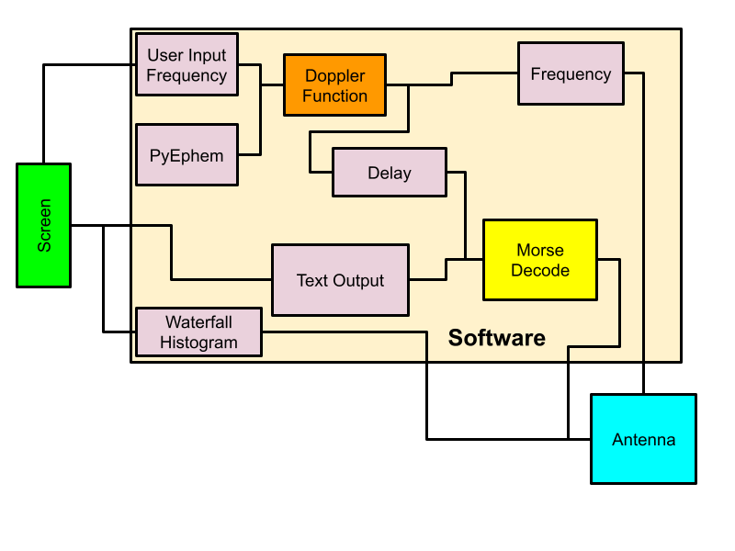
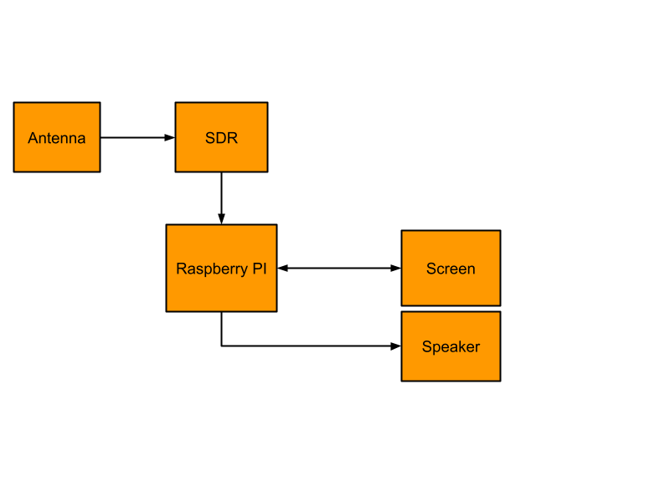
Beacon Box
The software will be created in Python using GNU Radio Companion and PyEphem it will be running on an SDR and Raspberry PI.
Notes:
wip

Slide 77
Mechanical
Slide

Slide 78
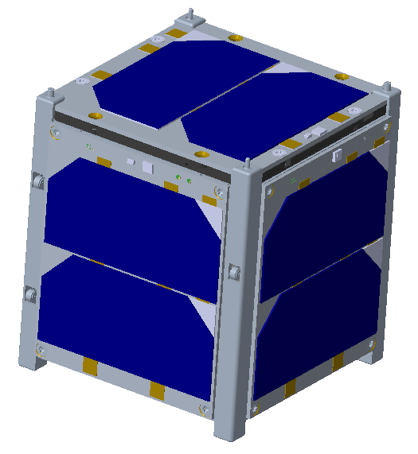
CubeSat Model
The CubeSat is a 1U design that is 10 cm x 10 cm x 11 cm and 1.33 kg max
The CubeSat design consists of the following components
Frame
Board Stack
Antenna
Solar Cells
The CubeSat design will meet the mechanical requirements outlined in the following specifications
CubeSat Design Specification (CDS Rev 13)
Launch Services Program Requirements Document (LSP-REQ-317.01 B)
Nanoracks CubeSat Deployer Interface Control Document (NR-NRCSD-S0003)
Launch Vehicle Requirements Document (TBD)
Slide
Notes:
Anthony

Slide 79
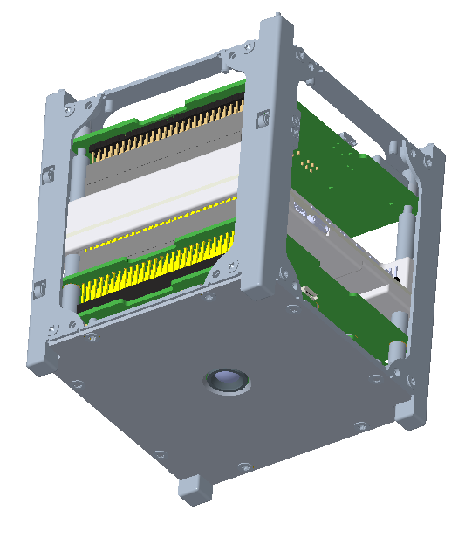
CubeSat Model
-Z Solar Cell
Frame
Antenna
Roller Kill Switches (3X)
Board Stack
X/Y Solar Cell (4X)
+Z Closeout Panel
+Z
Camera
(mounted to Payload Board)
Slide

Slide 80
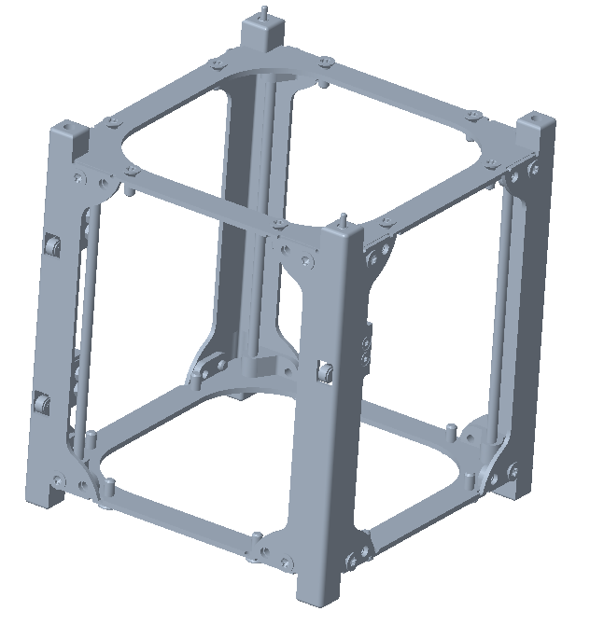
CubeSat Frame
Separation Spring (2x)
-Z Plate
Purchased from EnduroSat
Open frame, multi-piece construction design
Has flight heritage
Material: Aluminum
Finish: Hard anodized surface
Mass: 120g
Threaded Brass Rod (4x)
Side Rails (4x)
+Z Plate
Slide

Slide 81
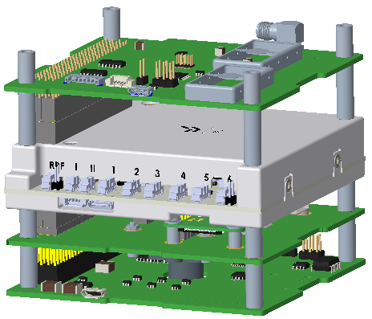
Board Stack
Aluminum Standoff (16x)
Radio Board
Electrical Power System (EPS1)
(Provides power to the CubeSat)
Payload Board
(Has the camera and Raspberry pi)
Avionics Board
(Board has a hole for the camera)
Slide

Slide 82
Currently Working On? Going into Flight Model Build…
Setting up the Prototype and fixing problems that may arise
Finalizing and purchasing the +Z closeout panel
Slide

Slide 83
Prototype 2 Results
Slide

Slide 84
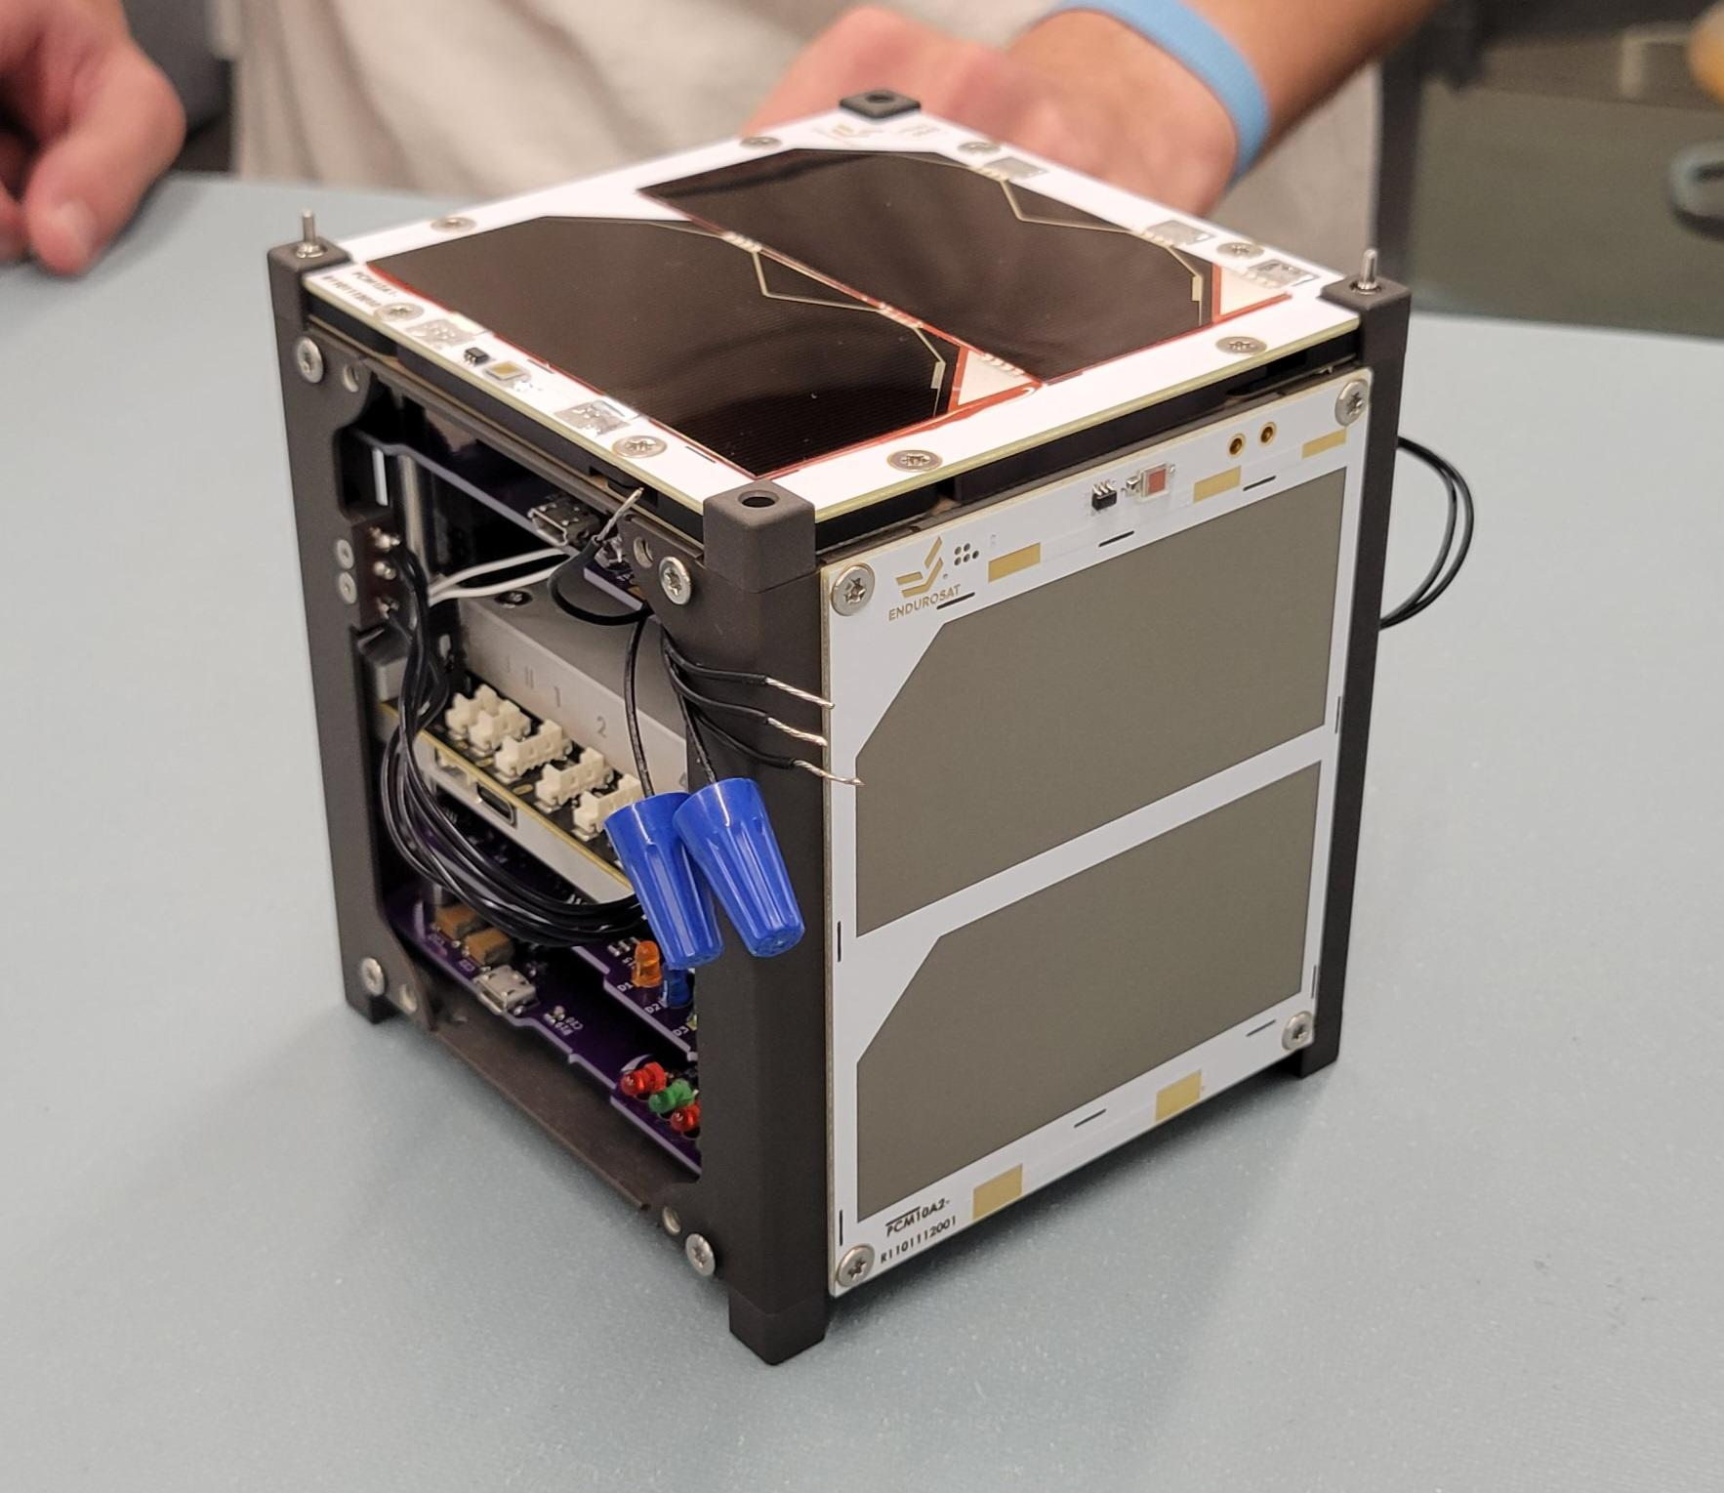
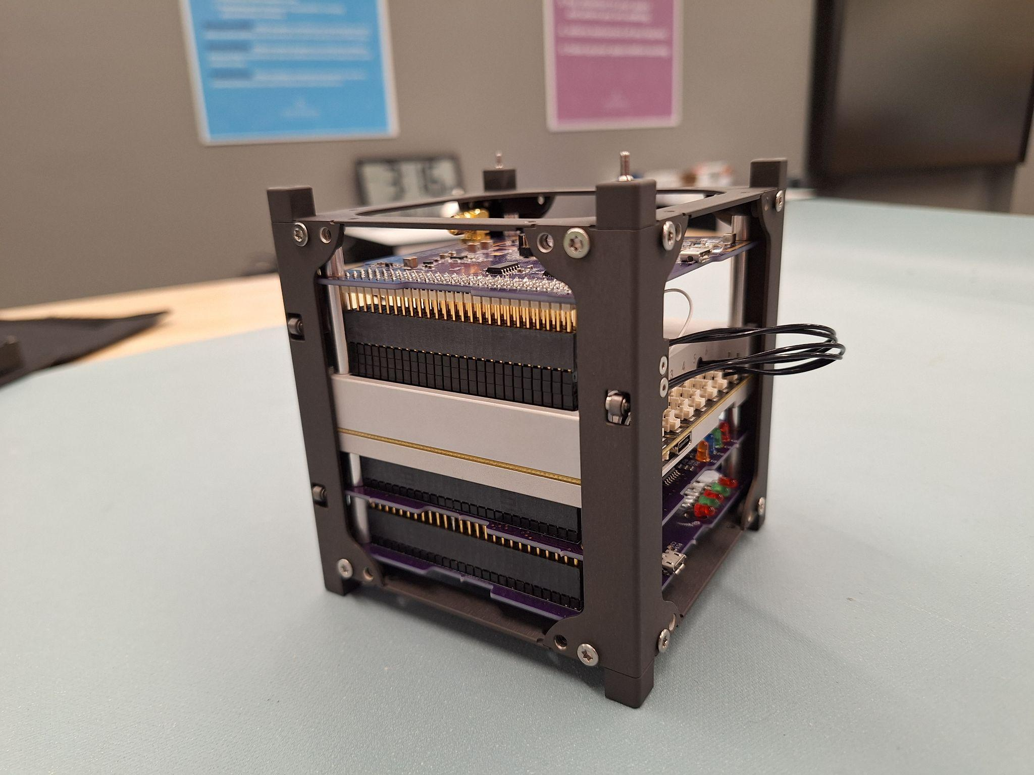
Prototype 2 Process (Fit Check)
Assembled the CubeSat to ensure each component could fit and the standoffs were correct
Slide

Slide 85
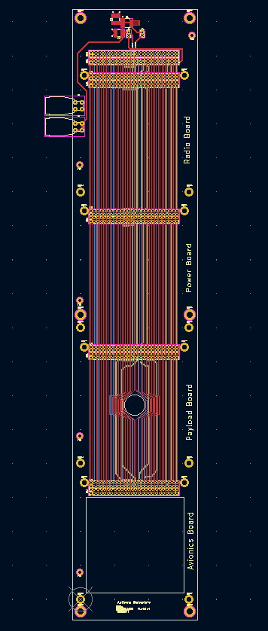
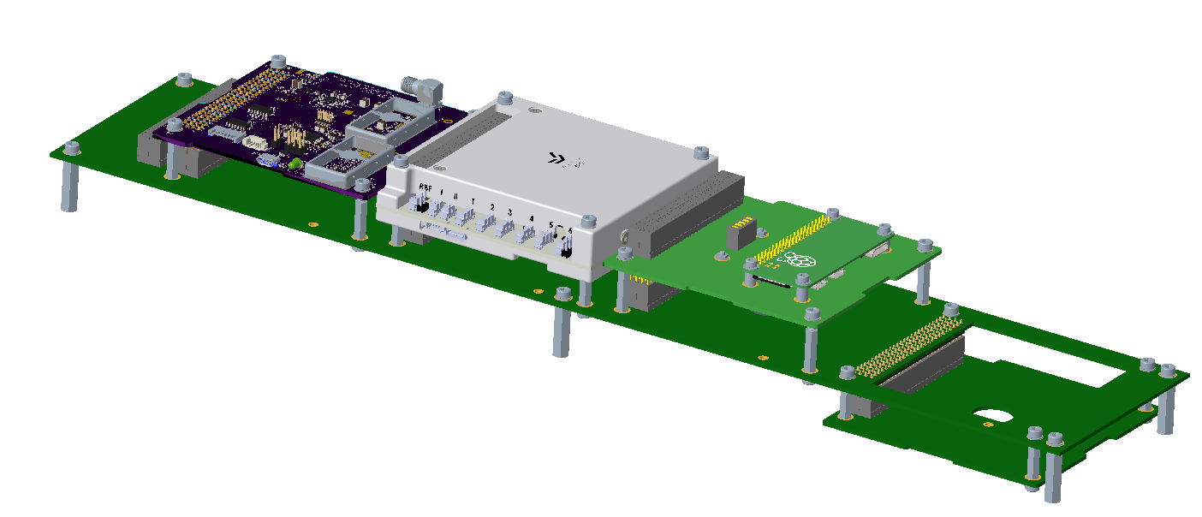
Prototype 2 Process (FlatSat)
Designed and wired the FlatSat Board in KiCAD and Creo so that other Teams could test
Creo CAD Model
KiCad PCB Layout
Slide

Slide 86
What We Learned from Prototype 2
The release switch for the CubeSat was rubbing against the side of the frame, making it so the switch couldn’t spring back
The standoffs weren’t right the right size and couldn’t be screwed on, so we switched to non-threaded standoffs
Slide

Slide 87
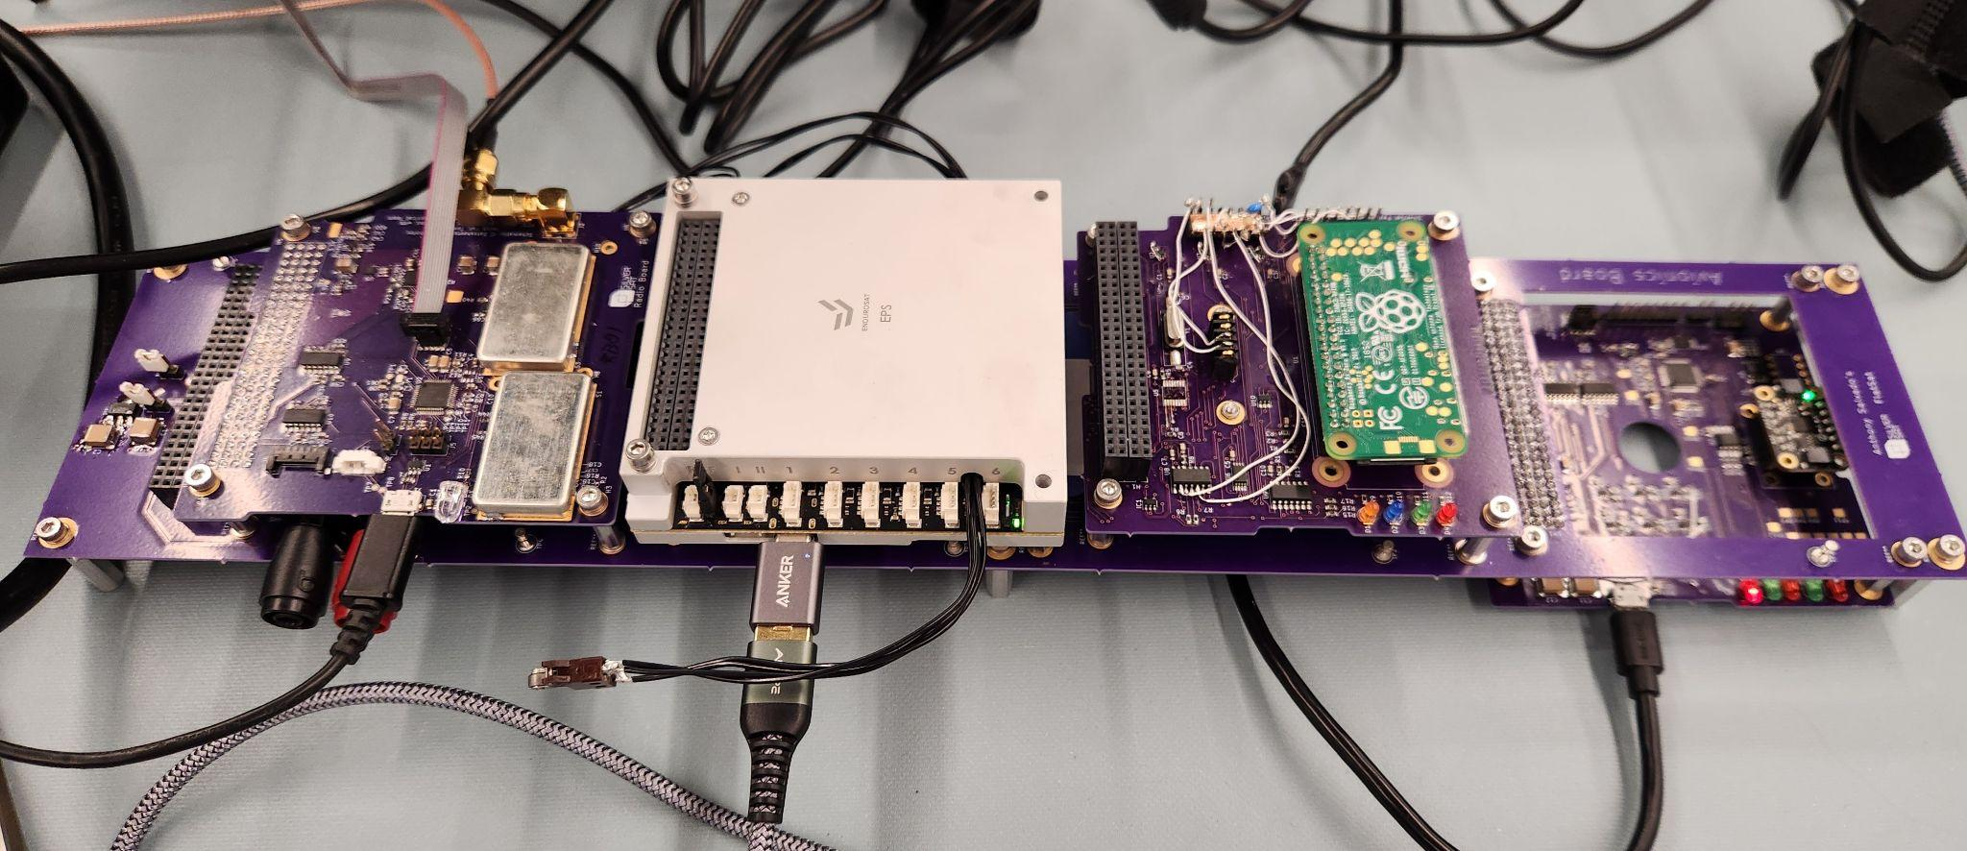
FlatSat Testing
Long PCB board with connected headers for Radio, Battery, Payload, and Avionics side by side.
Also prototype Ground Station components with Radio Board, Raspberry Pi, and laptop for sending commands
Radios connected with a cable
External Radio for listening to beacon (morse code) and communication between Satellite and ground
Slide
Notes:
Noah

Slide 88
FlatSat Testing - Day in the Life
Day in the Life is the things we will do most days when we are in space
The big commands the Satellite will do are…
Set the Avionics real-time clock (once)
Turn on Payload for communication (Tweet)
Register a specific time for Payload to take a photo (Payload turns on at the correct time and takes a photo)
Turn on Payload for communication (Tweet w/ photo)
We tested the FlatSat to find out how long it took to tweet text, tweet different sizes of images, and take a picture
There are four pieces of data sent between the Satellite, the Ground Station, and Twitter; Auxup, Logsdown, Tweetdown, and Tweetup
Slide
Notes:
Charlotte

Slide 89
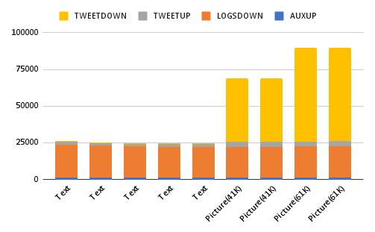
FlatSat - Tweet Amount
Bytes
Slide
Notes:
Charlotte

Slide 90
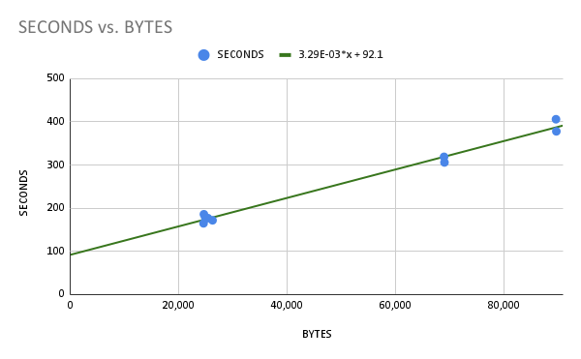
FlatSat - Tweet Times
Slide
Notes:
Charlotte

Slide 91
Outline
Overview & Mission Concept
Systems Engineering
Critical Designs (Major Components)
Power, Avionics, Radio, Ground, Payload, Mechanical
Prototype 2 Results
FM Integration and Test
Programmatics
Conclusion/Outbrief
Slide

Slide 92
Flight Model Build Plan
Fab Bare Avionics Board
Populate Avionics Board
Guidance and Control Board
Microcontroller Circuit Card
Real-Time Clock Connectors
Fab Bare Radio Board
Populate Radio Board
Receiver
Beacon
FlatSat Test
Fab Bare Payload Board
Populate Payload Board
Raspberry Pi Zero
Camera
Connectors
Assemble board stack onto base plate
Install top plate and rails
Install solar panels, Antenna, and +Z closeout panel
Assembly complete
Purchase EPS1 Module
Purchase frame
Fab +Z closeout panel
Purchase Antenna
Purchase solar panels
Slide
Notes:
Aidan

Slide 93
Flight Model Test Plan
From Previous Slide “Build Plan”
Comprehensive Performance Test
Day In The Life (DITL) Test
Thermal Vacuum Bakeout (TVAC) Test*
Go for Launch!!!
Comprehensive Performance Test
Vibration Test
Deliver to Nanoracks
*Optional
Slide

Slide 94
Outline
Overview & Mission Concept
Systems Engineering
Critical Designs (Major Components)
Power, Avionics, Radio, Ground, Payload, Mechanical
Prototype 2 Results
FM Integration and Test
Programmatics
Conclusion/Outbrief
Slide

Slide 95
Risk Matrix
Risk # | Risk |  |  |  |  |  |  | L | C
1 | If critical personnel leave the team, then our critical path will be affected |  |  |  |  |  |  | 5 | 3
2 | If the program cannot train new members in a timely fashion, then our critical path will be affected |  |  |  |  |  |  | 5 | 3
10 | If Elon Musk changes critical rules that harms our access to Twitter (now X), then our mission success criteria regarding sending tweets may be affected |  |  |  |  |  |  | 3 | 3
11 | If mentors are unavailable to assist with major decisions and tasks, then our critical path may be affected |  |  |  |  |  |  | 3 | 3
3 | If we cannot acquire facilities for building and securing flight hardware, then our delivery may be delayed |  |  |  |  |  |  | 2 | 4
16 | If the flight EPS repair delays the flight build, then the delivery to Nanoracks may be delayed |  |  |  |  |  |  | 2 | 4
17 | If we need to add a secondary Radio path to command off our primary transmitter, then our delivery may be delayed. |  |  |  |  |  |  | 2 | 4
7 | If data takes too long to send, then we will not complete a tweet in a pass |  |  |  |  |  |  | 2 | 3
5 | If certified amateur Radio members are not available at the Ground Station, then links may not be established |  |  |  |  |  |  | 1 | 4
15 | If SilverSat doesn’t meet criteria for amatuer Radio frequency coordination, then our schedule will be delayed. |  |  |  |  |  |  | 2 | 2
6 | If temperature exceeds parts limits, then critical functions may fail |  |  |  |  |  |  | 1 | 3
12 | If proper equipment/facilities cannot be secured for flight I&T testing, then the SilverSat CubeSat may fail Nanoracks testing or in Operations |  |  |  |  |  |  | 1 | 3
8 | If we experience long delays in acquiring parts because of the supply chain shortages, then our delivery may be delayed |  |  |  |  |  |  | 1 | 1
4 | CLOSED: If an expensive component breaks before launch requiring us to replace it, then our delivery may be delayed |  |  |  |  |  |  | 1 | 4
9 | CLOSED: If we cannot meet in person more often, then our critical path will be affected |  |  |  |  |  |  | 1 | 3
13 | CLOSED, COMBINED WITH 12: If proper equipment/facilities cannot be secured for flight I&T testing, then the SilverSat CubeSat may fail in Operations |  |  |  |  |  |  | 1 | 3
14 | CLOSED: If we cannot find a new place to meet, then our critical path will be affected. |  |  |  |  |  |  | 1 | 3
 | 5
 | 4 | 5 | 3,16,17
 | 3 | 6,12 | 7 | 10,11 |  | 1,2
 | 2 |  | 15
 | 1 | 8
 |  | 1 | 2 | 3 | 4 | 5
 |  | Likelihood (L)
Consequence (C)
Slide
Notes:
Zoe

Slide 96
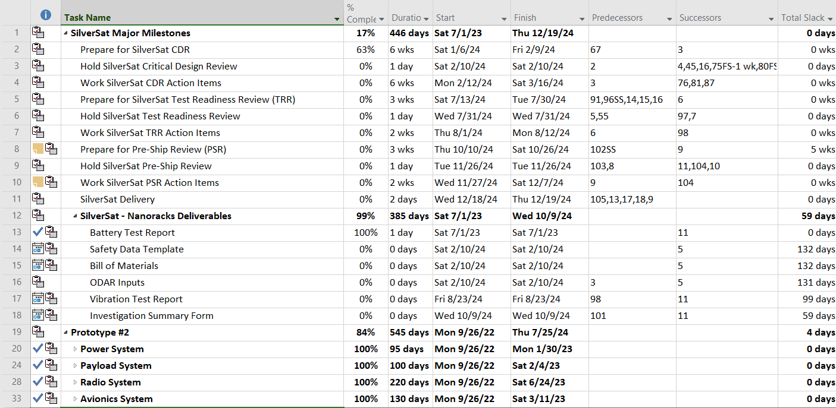
SilverSat Schedule (1 of 4)
Slide

Slide 97
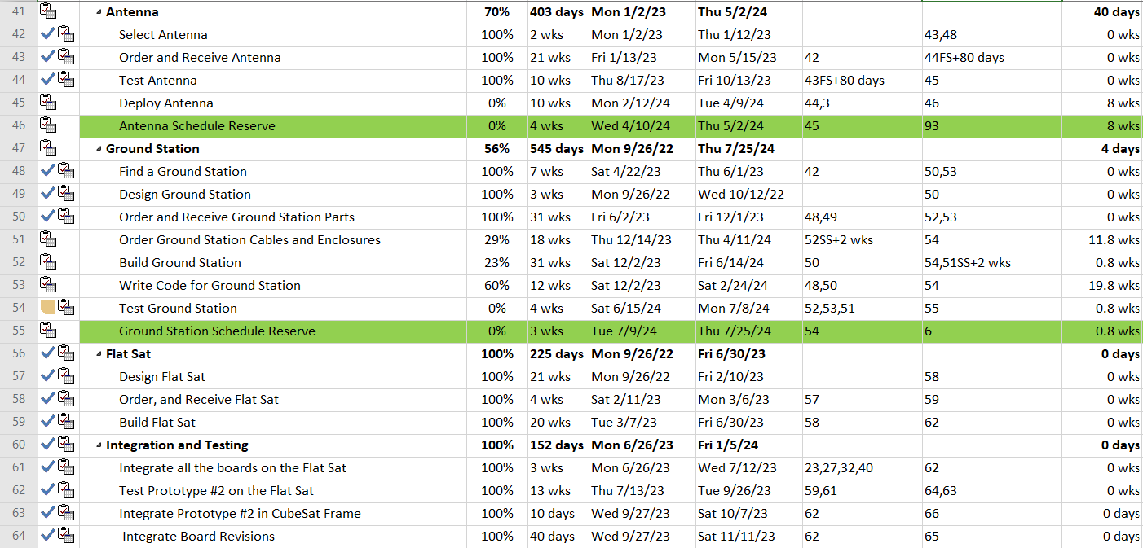
SilverSat Schedule (2 of 4)
Slide

Slide 98
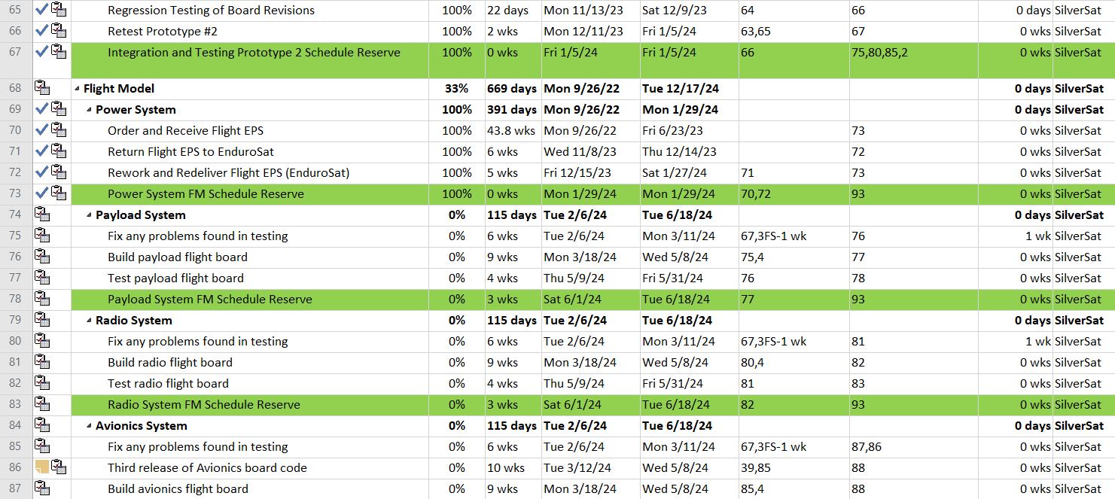
SilverSat Schedule (3 of 4)
Slide

Slide 99
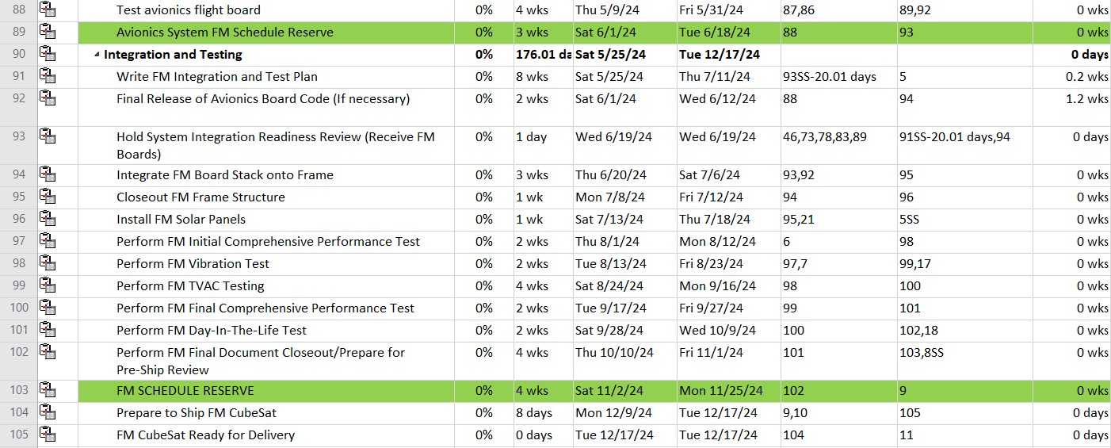
SilverSat Schedule (4 of 4)
Slide

Slide 100
SilverSat Open Items Update
Attitude Control - Need to conduct detailed design for passive magnetic stabilization
Open - Have conducted initial simulations only. Need to analyze further, choose magnetic materials, and incorporate into the design
Thermal Design - Need to conduct thermal analysis
Open - No analysis to date
Design does not contain anything ‘out of family’ for 1U missions. Expect our thermal profile to be similar.
Power budget is sensitive to battery heater cycling
Antenna
Resolved - Using the EnduroSat Antenna. Purchased an EM Antenna for conducting one deployment test, and measure RF return loss.
Spacecraft Telemetry
Resolved - Implemented RReport command to Avionics
Slide
Notes:
Dave

Slide 101
SilverSat Open Items Update
Flight Model I&T Facilities - Need to secure where we can store flight components, and assemble/test the flight unit
Open
Secured facilities in Columbia for PCB population
Evaluating using the APL STEM facilities for flight build
Wish to secure facilities for environmental testing, but it is not a requirement for flight
Nanoracks will facilitate the vibration testing required for score
Ground Station Facilities - Need to secure a location for Ground Station
Resolved
Working with Goddard Amateur Radio Club to use their facilities
Designed Ground Station equipment to be portable
Materials - The camera contains ABS plastic
Resolved - ABS is an acceptable material for Nanoracks
Slide
Notes:
Dave

Slide 102
Outline
Overview & Mission Concept
Systems Engineering
Preliminary Designs (Major Components)
Power, Avionics, Radio, Ground, Payload, Mechanical
Prototype 2 Results
FM Integration and Test
Programmatics
Conclusion/Outbrief
Slide

Slide 103
Conclusion and Thank You!
The SilverSat Team is ready for Flight Build and Test
We would like to thank you, the Reviewers, for your time and your feedback
We would also like to thank those individuals and organizations that have supported our efforts to date
AGI, Inc
The Maryland Space Business Roundtable
Rockville MakerSpace
Steve Morris, Catylator, LLC.
Nanoracks
NASA CSLI Partners
SilverSat Limited logo designed by Brent Almond, Designer Daddy
Slide
Notes:
Zoe

Slide 104
Questions?
Slide

Slide 105
Review Board Outbrief
How did the CDR go?
Do you have any comments or suggestions for us?
Do you have any action items for us?
Slide

Slide 106
Backup Slides
Slide

Slide 107
SilverSat Risk Matrix - Likelihood Criteria
Type || Rank | 1 | 2 | 3 | 4 | 5
Technical - estimated likelihood of not meeting mission requirements (educating) | 0-15% | 16-25% | 26-50% | 51-75% | >75%
Cost - estimated likelihood of exceeding available funds | 0-5% | 6-10% | 11-25% | 26-50% | >50%
Schedule - estimated likelihood of missing delivery date | 0-15% | 16-25% | 26-50% | 51-75% | >75%
Slide
Notes:
Zoe

Slide 108
SilverSat Risk Matrix - Consequence Criteria*
Slide
Type || Rank | 1 | 2 | 3 | 4 | 5
Technical | No impact to full mission success criteria | Minor impact to full mission success criteria | Moderate impact to full mission success criteria. Minimum mission success criteria are achievable with margin | Major impact to full mission success criteria. Minimum mission success criteria are achievable | Minimum mission success criteria are not achievable
Cost | <2% increase over allocated and negligible impact on reserve | Between 2% and 5% increase over allocated and can handle with reserve | Between 5% and 7% increase over allocated and cannot handle with reserve | Between 7% and 10% increase over allocated and/or exceeds proper reserves | >10% increase over allocated and/or cannot handle with reserve
Schedule | No or negligible slip in schedule | Slip in schedule that does not impact critical path/delivery | Slip in schedule that does impact critical path/delivery, but can be mitigated with schedule reserve | Slip in schedule that does impact critical path/delivery and cannot be mitigated with schedule reserve; slip to delivery = 1-3 months | Slip in schedule that does impact critical path/delivery and cannot be mitigated with schedule reserve; slip to delivery = >3 months
* Criteria are based on GSFC-STD-0002
Notes:
Zoe

Slide 109
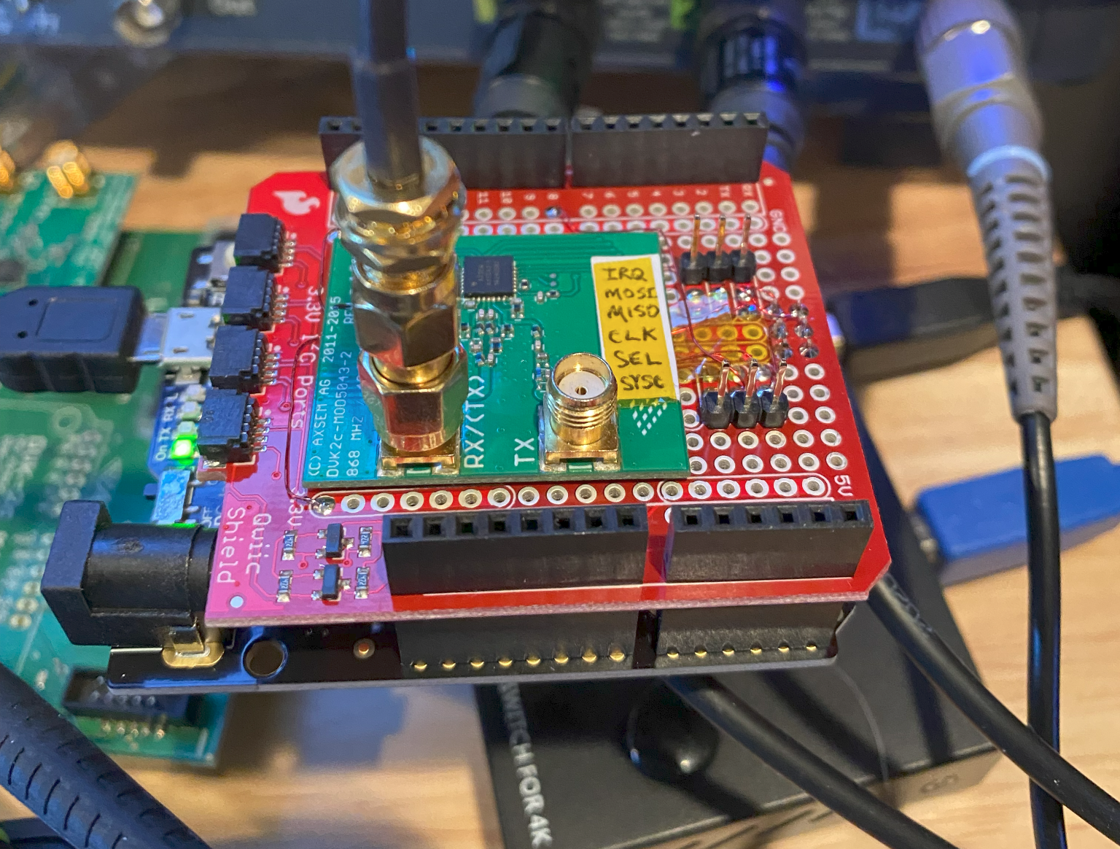
Test Ground Station Hardware (Simplified)
Nom. Pout ~15dBm
Can configure through SW to about 0 dBm (est.)
Nom. rcvd pwr ~ -67 to -97 dBm
Nom. Pout +29dBm
Nom rcvd pwr ~ -96 to -126dBm (assuming 0 dBm out from Dev platform)
Leakage pwr est ~ -50dBm (80dB), shielded box effectiveness needs to be on order of 80-90 dB. (leakage needs to be at or below noise floor, not sensitivity)
AX5043 “Shield”
-96dB
Flatsat
Expected receiver sensitivity between -110 and -120dBm
Total attenuation required 115 to 125dB.
Shielded enclosure required to complete testing (in fully assembled configuration)
Link is not symmetric; we’re testing FlatSat Rx, so its okay that we are not at noise floor of Ground Station Radio
“Ground station” PC
Ser0
Adafruit Metro M0
Radio Debug Serial
RPi (debug logging)
Radio Debug Serial
Laptop
FTDI cable
Ser1
Wireless Access Point (or phone)
RPi 4
Dev platform
Slide
109
Notes:
Aidan

Slide 110
Radio Communication Characteristics
Parameter | Value
Modulation (data mode) | GMSK (h=0.5)
Data encoding | NRZI
Deviation | +/- 2.4 kHz (h=0.5)
Transmit BW | 28.8 KHz (main lobe) (19.2kbaud), 14.4 KHz (9600 baud)
Symbol rate (BITRATE) with FEC | 19.2kbps
Symbol rate (BITRATE) without FEC | 9600 bps
FEC | Uncoded, or Rate 1/2 , k=7 Convolutional
Operating frequency range | 400 to 520 MHz
Operating frequency | TBD
Receiver Bandwidth | 14400 Hz (9600) 28800 Hz (19200)
Error control | TBD
Radio Serial1 settings | 19200, N, 8, 1
Radio Serial0 settings | 57600, N, 8, 1
Slide

Slide 111

What Way are We Pointing?
“The Antenna is positioned at the origin of the coordinate system hence the Antenna boresight (θ =0 deg and φ =0 deg) is along the Z axis on the top cover of the Antenna.”
Z-axis
ANTENNA
CS
So, if the camera is pointed down, then we’re LHCP
Slide

Slide 112

Top-Level Diagram
Cable
To Outside Switch
Power Supply
Cable
To Filter
GROUND
GS Transceiver PCB
Cable
Driver Amplifier
Power Amplifier
Inside Segment
PROXY
Cable
From LNA
Need to think about lightning protection here too
Add lightning arrestors at entry
From PA
Outside Segment
PA needs 13.8V @ 13A, N-connector in/out.
Is there an interface on PA? PTT?
To Rx
Slide

Slide 113
Prototype Radio Code Main Loop
(Mentor Version*)
Forward to endpoint
N
Y
* Student code used for Morse Code Generation
TX
State
Y
RTS?
N
pkt rcvd?
CCA
Arrows indicate main loop in idle state
Important points:
Single threaded, non-blocking to max extent possible
Sets up and manages Radio
Continually polls interfaces (Serial0, Serial1, SPI)
No flow control. BIG buffers
Transmit/Receive state must be changed by software
Performs clear channel assessment, transmits when clear
Processes cmds, executes if local, forwards if remote
Fast frequency updates for doppler compensation
N
Poll Interfaces
Process cmd buffer
Process data buffer
TX
State?
Y
TX
Buff empty
?
Tx Pkt
Cmd buff
Data buff
Command Processor
Y
TX
Busy?
Remote
CMD
Local
CMD
Exec Cmd
Process packet
N
RX state
Slide
Notes:
Isaac using Tom's script below.
The radio processor has two serial interfaces. Neither interface has flow control. Incoming data is buffered. Only complete packets are processed..
The transceiver (AX5043) is connected to the processor via the SPI bus. The radio has two states, transmit and receive. It must be commanded into the appropriate state by the processor. The transceiver idles in the receive state.
Incoming serial packets are KISS encoded. This is used to delimit packets in the buffers. The KISS address byte is used to determine local commands versus remote commands intended for the satellite.
Packets intended to be transmitted are KISS decoded to guarantee a fixed maximum length. Radio (over-the-air) packets are HDLC encoded by the AX5043.
AVIONICS commands are limited to ASCII characters, so we don’t have to remove KISS encoding. Local commands are executed immediately.
While waiting for data to arrive, the code follows the arrows.
It first polls the serial interfaces, and if there is data in the buffers it is processed.
Command packets intended for the local radio are immediately executed, otherwise they are transferred into the data buffer.
If the radio is in the transmit state, it begins sending out packets to the radio. The radio has a separate FIFO that can hold one packet at a time.
In the receive state, the radio is polled to see if a packet has arrived. Received packets are KISS encoded and forwarded to the appropriate serial interface.
A clear channel is determined by the CCA block. The transmit state can only be entered when the receiver is idle, the channel is clear, and if there is something to send. Packets in the data buffer are transmitted when the channel is clear.
When the transmit buffer is empty, the radio reverts to the receive state.

Slide 114
Radio Design Decisions
Payload talks directly to the Radio when tweeting
No AX.25. Opted for tncattach over kissattach to reduce per packet overhead
No layer 2 protocol, just TCP. No HW flow control
We rely on big buffers and TCP to handle end to end flow and error control
Test Ground Station is assumed to be a duplicate of the Satellite Radio, without PA (see Ground Station section)
Doppler compensation only on ground (none on satellite)
Doppler offsets provided by Ground Station software
Radio can re-tune quickly within expected doppler offset range (AX5043 supports FHSS)
Ground Station forwards offset to center frequency through local commands to Radio
Radio retunes up/down depending on TX/RX state and sign of offset
Slide

